Slide 1
Java Performance Tuning
Vivek Gohil

Slide 2
Agenda
Day 1 : JVM Internals, Memory, Garbage Collection and Profiling
Introduction to Performance Engineering
JVM Architecture Deep Dive
Java Memory Model and Heap Optimization
Garbage Collection Algorithms and Tuning
Profiling and Application Diagnostics

Slide 3
Agenda
Day 2 : Code Optimization, Concurrency, Microservices, DB and Best Practices
Code Level Performance Optimization
Concurrency & Thread Optimization
Microservices and JVM Performance
Database, Caching and IO Optimization

Slide 4
Session 1 : Introduction to Performance Engineering
Session Objective
Think in performance engineering mindset(not just tuning)
Understand how to measure before optimizing
Identify real-world bottlenecks
Know which tools to use and when

Slide 5
Session 1 : Introduction to Performance Engineering
What is performance Tuning(vs Engineering) ?
Performance metrics
Throughput
Latency
Response time
Footprint
Common performance bottlenecks in Java applications
Tools overview:
Jconsole, Jvisualvm, JMC, JFR, Jstack, Jstat
APM tools: New Relic, Dynatrace, AppDynamics

Slide 6
What is Performance Tuning( vs Engineering) ?
Typical Mistake
“Application is slow – Increase heap / threads / DB pool”
This is guessing, not engineering.

Slide 7
What is Performance Tuning( vs Engineering) ?
Correct Definition
Performance Tuning = Reactive
Fix issues after they occur
Performance Engineering = Proactive + Scientific
Define SLAs
Measure baseline
Identify bottlenecks
Apply targeted optimizations
Validate information

Slide 8
Performance Engineering Cycle
Measure
Analyse
Optimize
Validate

Slide 9
Key Performance Metrics : Throughput
Throughput
Requests processed per second
Throughput = Total Requests / Time
Example : 10,000 requests in 10 sec :: 1000 req/sec

Slide 10
Key Performance Metrics : Latency
Latency
Time taken to process a request
Types
Average latency – misleading
P92 / P99 latency – real production metric
Example :
avg = 100ms
P99 = 2 seconds ! (bad UX)

Slide 11
Key Performance Metrics : Response Time
Response Time = Total time from client request to full response received
It is end-to-end not just what your code executes.
Includes
Network delay
Processing time
DB time

Slide 12
Key Performance Metrics : Memory Footprint
Memory Footprint = How much memory your application uses + how efficiently it uses it
It directly impacts
GC frequency
Latency
Scalability

Slide 13
Common Performance Bottlenecks : CPU Bottlenecks
CPU Bottlenecks
Symptoms
High CPU usage
Threads in RUNNABLE state

Slide 14
Common Performance Bottlenecks : Memory Bottleneck
Memory Bottlenecks
Symptoms
Frequent GC
High allocation rate
OutOfMemoryError

Slide 15
Common Performance Bottlenecks : Thread Contention
Thread Contention
Symptoms
Blocked threads
Low CPU but slow app

Slide 16
Common Performance Bottlenecks : I/O Bottlenecks
IO Bottlenecks
Symptoms
Slow DB calls
Network delays

Slide 17
Common Performance Bottlenecks : Database Bottleneck
Database Bottleneck
Common issues
N + 1 queries
Missing indexes
Full table scan

Slide 18
Tools Overview
JVM Tools
JConsole
Basic monitoring
Thread, memory
VisualVM
CPU profiling
Heap dump analysis
JMC – Java Mission Control
Production-grade tool
JFR – Java Flight Recorder
Low overhead profiling
Jstack
Thread dump analysis
Jstat
GC stats

Slide 19
Tools Overview
APM Tools
New Relic
Dynatrace
AppDynamics
Used for
Distributed tracing
SLA monitoring
Bottleneck detection

Slide 20
MCQ
1. What is the primary goal of performance tuning?
To reduce code size
To improve application speed, scalability, and resource usage
To increase memory consumption
To add more features
Correct Answer: B Explanation: Performance tuning focuses on optimizing speed, scalability, and efficient resource utilization.
2. Which of the following is a key performance metric?
Code readability
Throughput
Number of classes
Lines of code
Correct Answer: B Explanation: Throughput measures how much work an application can handle in a given time.

Slide 21
MCQ
3. What does latency represent in a system?
Total number of requests processed
Time taken to respond to a request
Memory usage of application
CPU utilization percentage
Correct Answer: B Explanation: Latency is the delay between request and response
4. Which of the following is a common performance bottleneck in Java applications?
Proper indexing
Efficient garbage collection
Excessive synchronization
Optimized algorithms
Correct Answer: C Explanation: Excessive synchronization can cause thread contention and reduce performance

Slide 22
MCQ
5. Which tool is used for Java monitoring and profiling?
Git
Jconsole
Maven
Jenkins
Correct Answer: B Explanation: JConsole is a built-in Java monitoring and management tool.

Slide 23
Session 2 : JVM Architecture Deep Dive
Session Objective
Understand how JVM executes Java programs internally
Identify JVM memory components and their roles
Understand JIT & runtime optimizations
Relate JVM internals with performance issues

Slide 24
What happens inside normal JDK?
Java Code
javac Hello.java
.class
java Hello
JVM
Output
Output

Slide 25
What happens inside JVM?
Class Loading
The JVM starts by loading the necessary classes and resources required by the program.
It searches for bytecode files(.class) that correspond to the classes used in the program and loads them into memory.
Bytecode Verification
Once the classes are loaded, the JVM preforms bytecode verification. It checks the bytecode for any violations of the Java language specification.
This step ensures the safety and security of the JVM by preventing the execution of malicious or malformed bytecode.
Just-In-Time(JIT) Compilation
After the bytecode is verified, the JVM employs a Just-In-Time(JIT) compiler to convert the bytecode into machine code. The JIT compiler analyzes the bytecode and identifies portions of the code that are frequently executed, known as hot spots.
It optimizes the hot spots by translating them into highly optimized machine code, specific to the underlying hardware and operating system.
This compilation process is known as dynamic or on-the-fly compilation because it happens during runtime.
Execution
Once JIT compilation is completed, JVM starts executing the optimized machine code.
It interprets the bytecode and executes the corresponding instructions. At this stage, the Java program is running natively on the underlying hardware, similar to programs written in other programming languages.

Slide 26
Understanding Bytecode instructions
Step 1 : Write Simple Java Code
Step 2 : Compile it
public class Test {
public static void main(String[] args) {
int a = 10;
int b = 20;
int c = a + b;
System.out.println(c);
}
}

Slide 27
Understanding Bytecode instructions
JVM Automatically adds default constructor
public class Test {
public Test();
Code:
0: aload_0
1: invokespecial #1 // Method java/lang/Object."<init>":()V
4: return
public static void main(java.lang.String[]);
Code:
0: bipush 10
2: istore_1
3: bipush 20
5: istore_2
6: iload_1
7: iload_2
8: iadd
9: istore_3
10: getstatic #7 // Field java/lang/System.out:Ljava/io/PrintStream;
13: iload_3
14: invokevirtual #13 // Method java/io/PrintStream.println:(I)V
17: return
}
Load current object (this)
Call parent constructor (Object)
Value = 10
Stores in a

Slide 28
Types of Class Loaders
Bootstrap Class Loader – Loads core Java Classes
Extension Class Loader – Loads classes from the JDK extension library(lib/ext)
Application Class Loader – Loads classes from the applications classpath (your project classes)

Slide 29
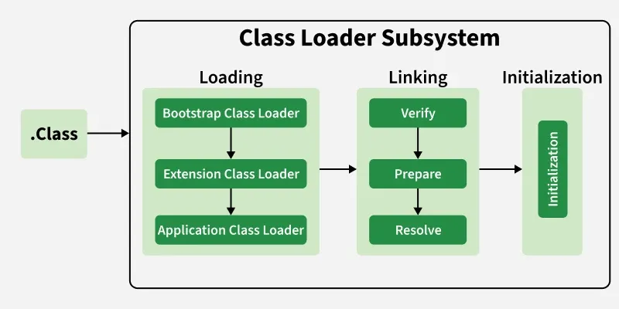
Class Loader Subsystem
Role
Loads .class files into JVM
Phases
Loading
Reads .class file
Creates binary representation
Linking
Verification – checks bytecode safety
Preparation – allocates memory for static variables
Resolution – replaces symbolic reference
Initialization
Executes static blocks

Slide 30
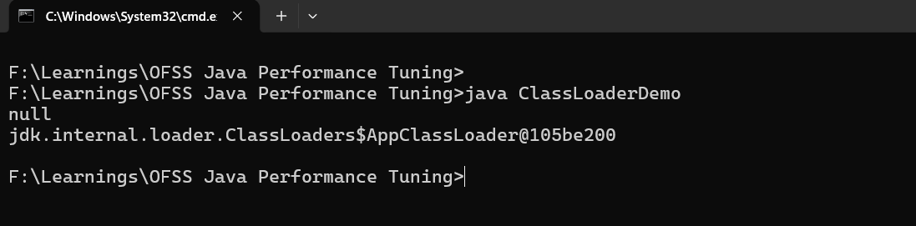
Class Loading Demo
When you run a Java program
Classes are not magically available
They are loaded by ClassLoaders
public class ClassLoaderDemo {
public static void main(String[] args) {
System.out.println(String.class.getClassLoader());
System.out.println(ClassLoaderDemo.class.getClassLoader());
}
}
String is loaded by Bootstrap Class Loader and its native
Your class is loaded by Application Class Loader

Slide 31
JIT Compiler & HotSpot Optimizations
Interpreter = slow but immediate
JIT = compiles hot code for speed
HotSpot Concept
Frequently executed code = Hot Methods
Converted to native code
Optimizations
Method inlining
Loop unrolling
Dead code elimination
Escape analysis

Slide 32
JIT Compiler & HotSpot Optimizations
Run twice – second run faster
public class JITCompiler {
public static void main(String[] args) {
long start = System.currentTimeMillis();
for (int i = 0; i < 100_000_000; i++) {
calculate();
}
System.out.println("Time: " + (System.currentTimeMillis() - start));
}
static int calculate() {
return 10 * 20;
}
}

Slide 33
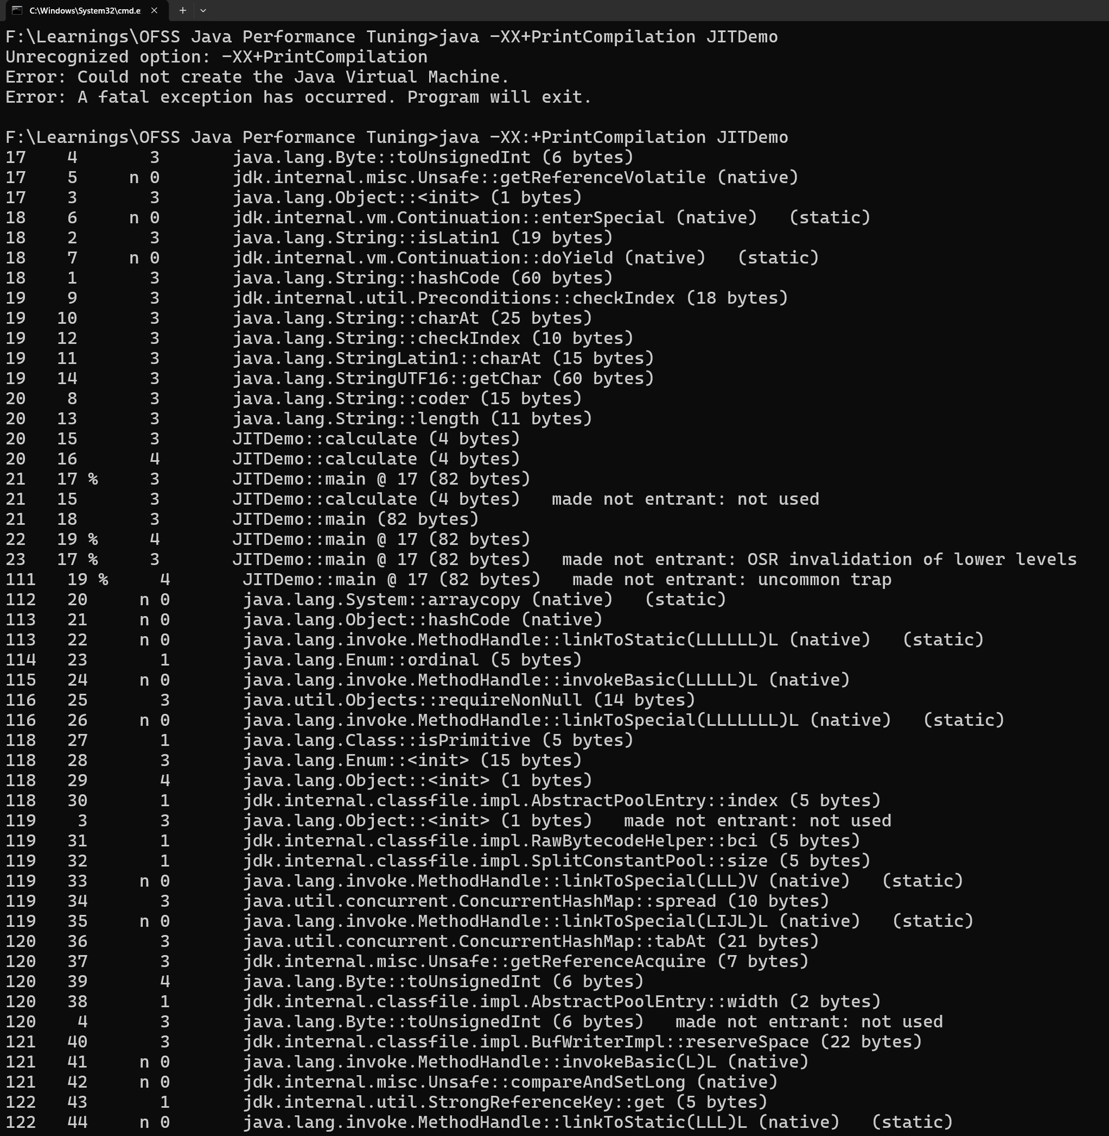
JIT Compiler & HotSpot Optimizations
First Column = Number of millisecond since the virtual machine started
Second Column = Order in which method or block is compiled
n = Native method
0 - 4 = What kind of compilation
1, 2, 3, 4 = Means the deeper level of compilation
% = Code is Natively compiled and now it is running in special part of memory called as code cache.
! = Exception Handling

Slide 34
JVM Memory Components (Core Section)
Memory Areas
Heap
Stack
Metaspace
Code Cache

Slide 35
Heap (Shared)
Objects stored here
GC runs here

Slide 36
Stack – Thread-specific
Stores method calls
Local variables
Fast access

Slide 37
Metaspace
Class metadata
Replaced PermGen (Java 8+)

Slide 38
Code Cache
JIT compiled code stored

Slide 39
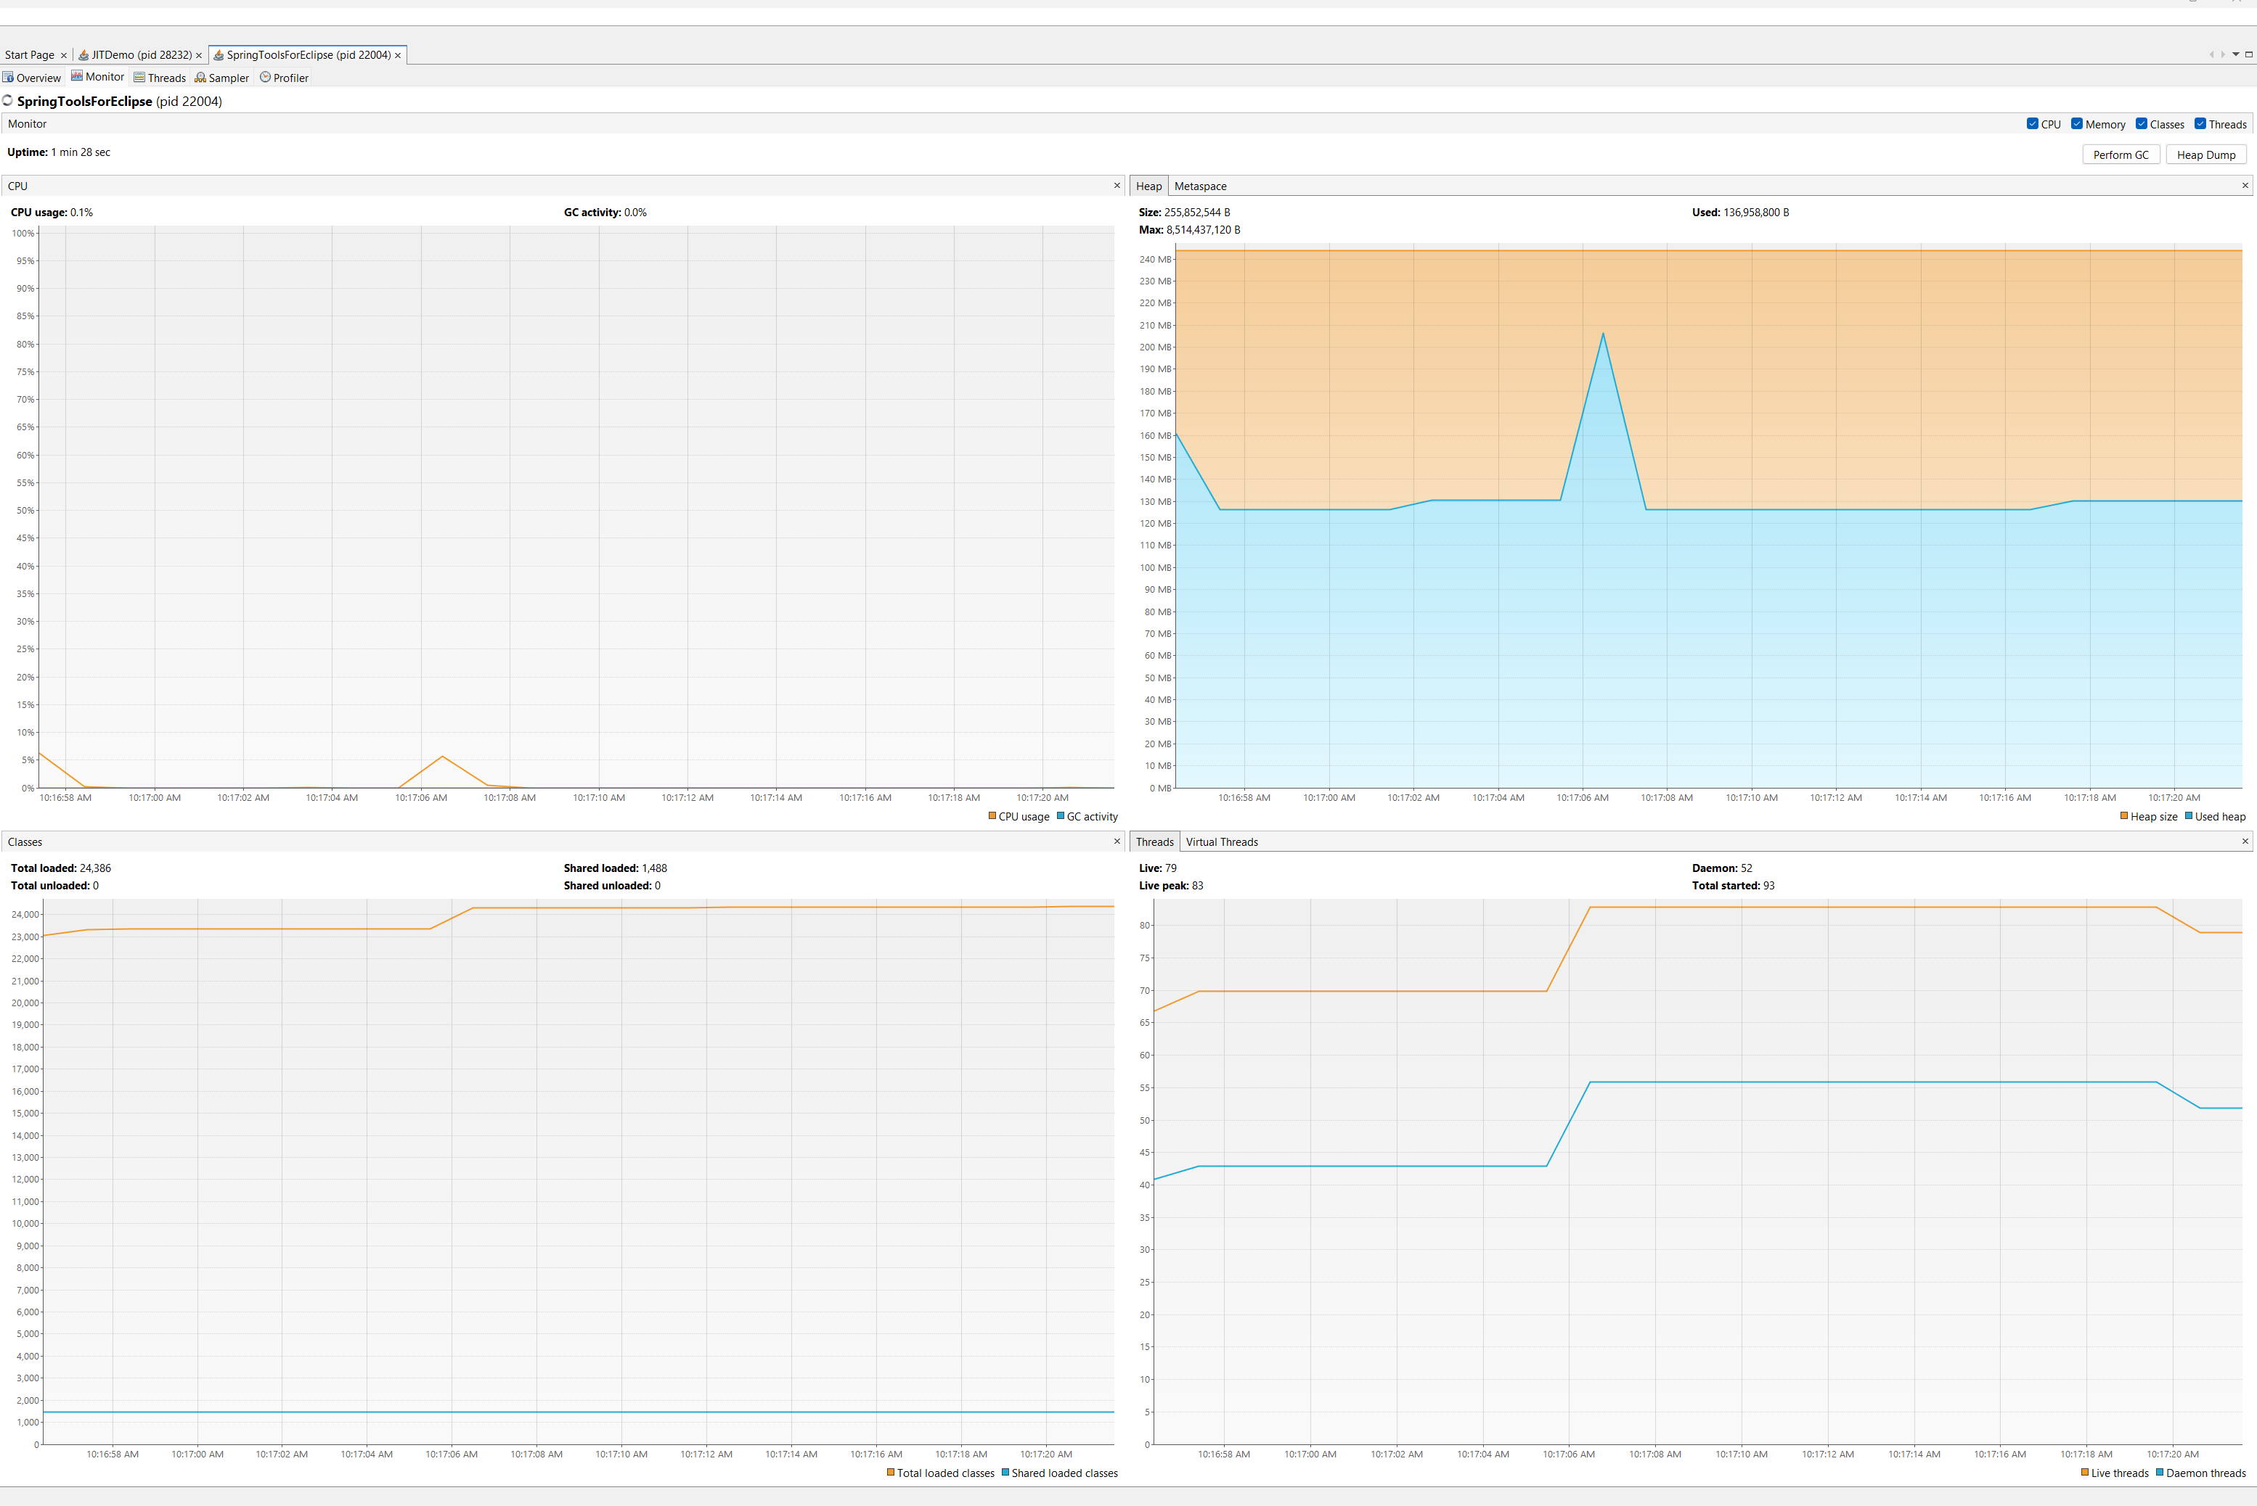
Memory Observation (Visual VM) : Demo

Slide 40
Object Lifecycle & Escape Analysis
Lifecycle
Created – Heap
Used
Becomes unreachable
GC Collects

Slide 41
Escape Analysis
JVM tries to answer
Does this object really need to go into Heap ?
Not all objects need Heap
Some objects can be stay in Stack
That’s what Escape Analysis decides
JVM is smart. If object is used only inside method, it avoids Heap allocation and puts it in Stack.

Slide 42
Why this matters for performance
Without Escape Analysis
Object will get stored in Heap
Which needs garbage collection
With Escape Analysis – Default in Java8+
Object will get stored in Stack
No garbage collection is required
Faster + less memory pressure

Slide 43
Important Clarification
Stack allocation is
Not guaranteed
Optimization done by JVM – JIT decides

Slide 44
Common Misconfigurations
Real-world Issues
Too small heap – frequent GC
Too large heap – long GC pauses
Wrong GC selection
Too many threads
Blocking I/O

Slide 45
MCQ
1. Which component of JVM is responsible for loading class files?
Execution Engine
Class Loader
Garbage Collector
JIT Compiler
Correct Answer: B Explanation: The Class Loader loads .class files into memory.
2. What is the primary role of the JIT (Just-In-Time) compiler?
Compile Java code to bytecode
Interpret bytecode line by line
Convert bytecode into optimized native machine code at runtime
Manage memory allocation
Correct Answer: C Explanation: JIT improves performance by converting frequently used bytecode into optimized native code.

Slide 46
MCQ
3. Which JVM memory area stores method-level data and class metadata?
Heap
Stack
MetaSpace
Code Cache
Correct Answer: C Explanation: MetaSpace stores class metadata (replaced PermGen in Java 8+).
4. Where are local variables and method calls stored?
Heap
Stack
MetaSpace
Code Cache
Correct Answer: B Explanation: Each thread has its own stack for method calls and local variables.

Slide 47
MCQ
5. What is Escape Analysis used for in JVM?
A. Detect memory leaks
B. Analyze thread scheduling
C. Determine if an object can be allocated on stack instead of heap
D. Monitor GC performance
Correct Answer: C Explanation: Escape Analysis helps optimize memory allocation by avoiding heap allocation when possible.

Slide 48
Session 3 : Java Memory Model & Heap Optimization
Session Objective
Understand how Java Memory Model(JMM) controls thread interaction
Identify visibility and ordering issue in multithreaded programs
Understand heap structure and object lifecycle
Analyse object creation cost and allocation patterns
Apply techniques to reduce GC pressure
Correlate memory behaviour with application performance

Slide 49
Java Memory Model (JMM)
Why sometimes one thread updates a variable but another thread doesn’t see it ?
What is JMM ?
Defines how threads interact through memory
Controls
Visibility
Ordering
Atomicity

Slide 50
Heap & Object Allocation
Key Regions
Young Gen
Eden
Survivor (S0,S1)
Old Gen

Slide 51
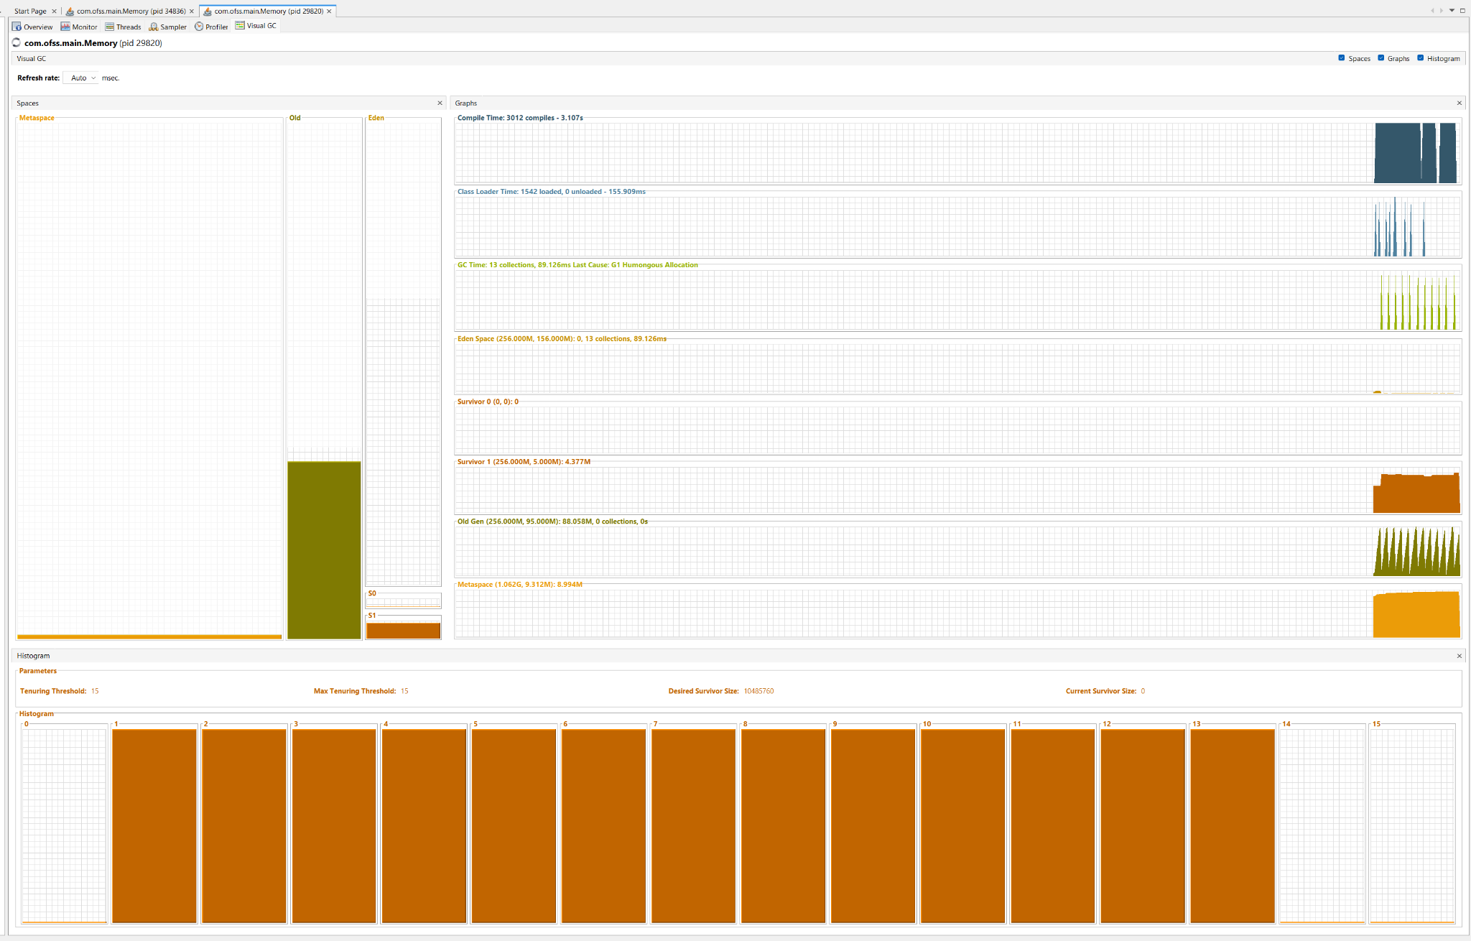
Young Generation – Where objects are born
Purpose
Handle newly created objects
Optimized for fast allocation & quick cleanup
Contains
Eden
Survivor S0
Survivor S1
Most objects in Java die quickly, so JVM keeps them in Young Gen for fast cleanup

Slide 52
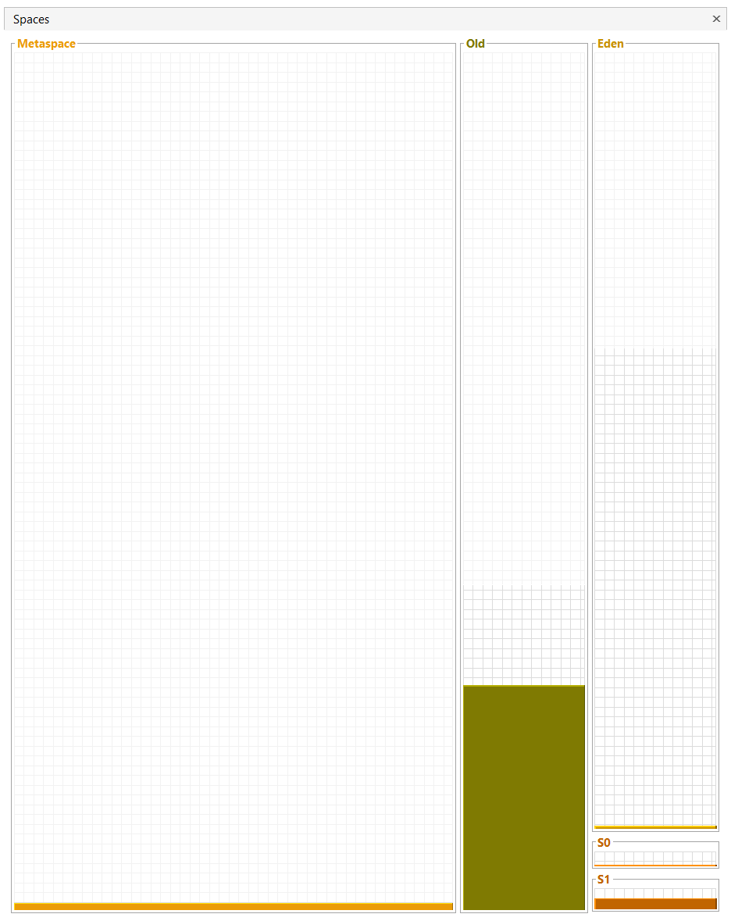
Eden Space (Object Birthplace)
Purpose
All new objects are created here
Every object you create using new goes into Eden first
Behaviour
Fills up quickly
When full – Minor GC triggered
What happens During GC ?
Unused objects – removed
Surviving objects – moved to Survivor

Slide 53
Survivor Spaces (S0 & S1)
Purpose
Some objects that survive Eden GC
Objects bounce between S0 and S1 until JVM decides they are long-lived.
Survivor spaces help JVM decide which objects are temporary and
Aging Concept
Each GC – object age increases
If age > threshold – moves to Old Gen

Slide 54
Old Generation ( Long-lived objects )
Purpose
Store objects that survived long enough are promoted to Old Gen
Behaviour
Less frequent GC
GC is slow and expensive
Major GC / Full GC
Triggered when Old Gen fills up
Causes
Long pauses
Performance Issues
Old Gen is where performance problem usually start

Slide 55
Object Creation Cost & Escape Analysis
Every object you create has a cost — not just memory, but CPU and GC overhead.
What happens when you write : new Object();
Behind the scenes:
Memory allocation is Eden
Object header initialization
Reference assignment
Later – GC has to clean it
Object creation is cheap, but cleaning them (GC ) is expensive.

Slide 56
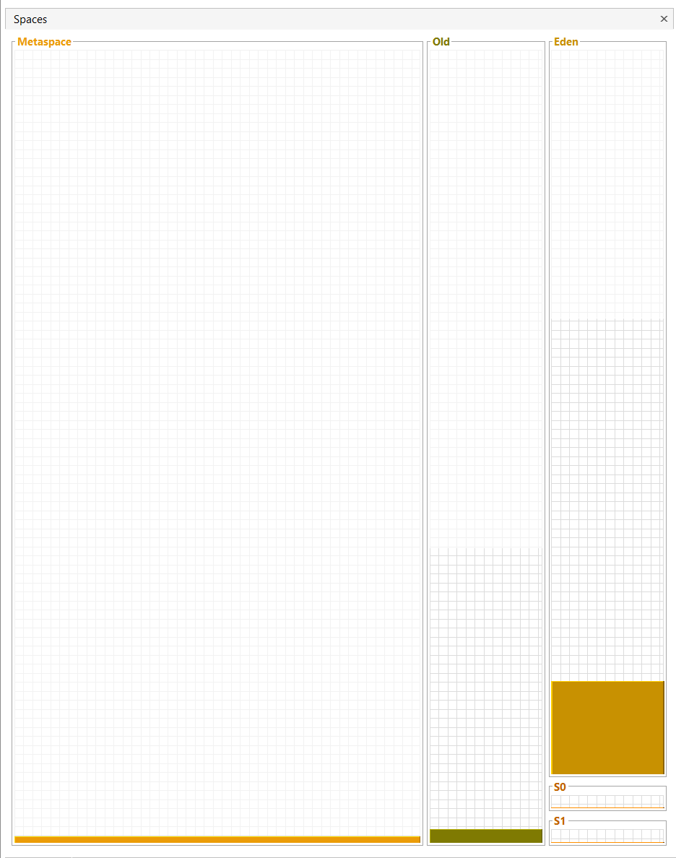
Object Creation Impact
public class ObjectCreationDemo {
public static void main(String[] args) {
while (true) {
String s = new String("performance");
}
}
}
Observation in VisualVM
Eden fills quickly
Frequent Minor GC
CPU usage increases

Slide 57
Escape Analysis
Case 1: Object Escapes (More GC)
Case 2: No Escape (Optimizable)
public class Escape {
static Object obj;
public static void main(String[] args) {
while (true) {
create();
}
}
public static void create() {
obj = new Object(); // Escapes to global
}
}
public class Escape {
public static void main(String[] args) {
while (true) {
create();
}
}
public static void create() {
Object obj = new Object(); // No escape
}
}

Slide 58
VisualVM observations
Behavior | EscapeYes | EscapeNo
GC Activity | Higher | Lower
Memory Pressure | High | Lower
Optimization | No | Yes

Slide 59
Reducing GC Pressure
GC problem are actually object creation problems
Avoiding temporary object creation
Using mutable objects effectively
Using Off-Heap Structures

Slide 60
Avoiding Temporary Object Creation & Mutable Objects
Bad
Better
for (int i = 0; i < 10000; i++) { String s = "Hello " + i;
}
StringBuilder sb = new StringBuilder();
for (int i = 0; i < 10000; i++) {
sb.setLength(0);
sb.append("Hello ").append(i);
}

Slide 61
Using Off-Heap Structures – Advanced but Powerful
What if we could store data outside JVM heap and avoid GC completely?
Off-heap memory is memory allocated outside the JVM heap, not managed by Garbage Collector.
Type | Managed By | GC Impact
Heap | JVM | Yes
Off-Heap | OS / Native | No

Slide 62
Why Use Off-Heap Memory
Problem
Too many objects – Frequent GC
Large data – long GC pauses
Memory fragmentation
Solution
Store large data outside heap
Reduce GC workload
Improve latency
List<ByteBuffer> list = new ArrayList<>();
while (true) {
ByteBuffer buffer = ByteBuffer.allocateDirect(1024 * 1024); // 1MB
list.add(buffer); // IMPORTANT: prevent GC
Thread.sleep(100);
}

Slide 63
Off Heap Memory : Risks & Caution
Problem 1 : Memory Leak
GC doesn’t control memory directly
If not released – memory leak
Problem 2 : Hard to Debug
Not visible in heap dump
Requires OS-level tools
Problem 3 : Limited Memory

Slide 64
MCQ
1. What does the Java Memory Model (JMM) primarily define?
JVM startup sequence
Memory layout of heap
Rules for visibility, ordering, and synchronization of shared variables
Garbage collection algorithms
Correct Answer: C Explanation: JMM defines how threads interact through memory, ensuring visibility and ordering guarantees.
2. Which of the following ensures visibility of changes across threads?
static keyword
final keyword
volatile keyword
transient keyword
Correct Answer: C Explanation: volatile ensures that updates to a variable are visible to all threads immediately.

Slide 65
MCQ
3. In JVM heap structure, where are newly created objects typically allocated?
Old Generation
MetaSpace
Young Generation
Stack
Correct Answer: C Explanation: Most objects are first created in the Young Generation (Eden space).
4. Which practice helps reduce GC pressure?
Creating many temporary objects
Using immutable objects everywhere
Avoiding unnecessary object creation
Increasing thread count
Correct Answer: C Explanation: Reducing temporary object creation lowers GC activity and improves performance.

Slide 66
MCQ
5. What is the benefit of escape analysis in heap optimization?
Improves network performance
Detects deadlocks
Avoids heap allocation for non-escaping objects
Increases GC frequency
Correct Answer: C Explanation: Objects that don’t escape a method can be allocated on the stack, reducing GC overhead.

Slide 67
Session 4 : Garbage Collection Algorithms & Tuning
Session Objective
Understand how GC works internally
Compare different GC algorithms
Read GC logs
Do basic JVM tuning

Slide 68
What is Garbage Collection ?
JVM automatically frees memory of unused objects.
Objects created – Heap
Objects no longer referenced – Garbage
GC removes them – Frees memory

Slide 69
Why GC matters for performance ?
GC is not free – It causes pause times (Stop – The – World)
API response delayed because GC paused thread
High GC – low throughput

Slide 70
GC Process – Core Concept
Mark
Sweep
Compact
Mark Phase
Find reachable object
Sweep Phase
Remove unused objects
Compact Phase
Remove fragmentation

Slide 71
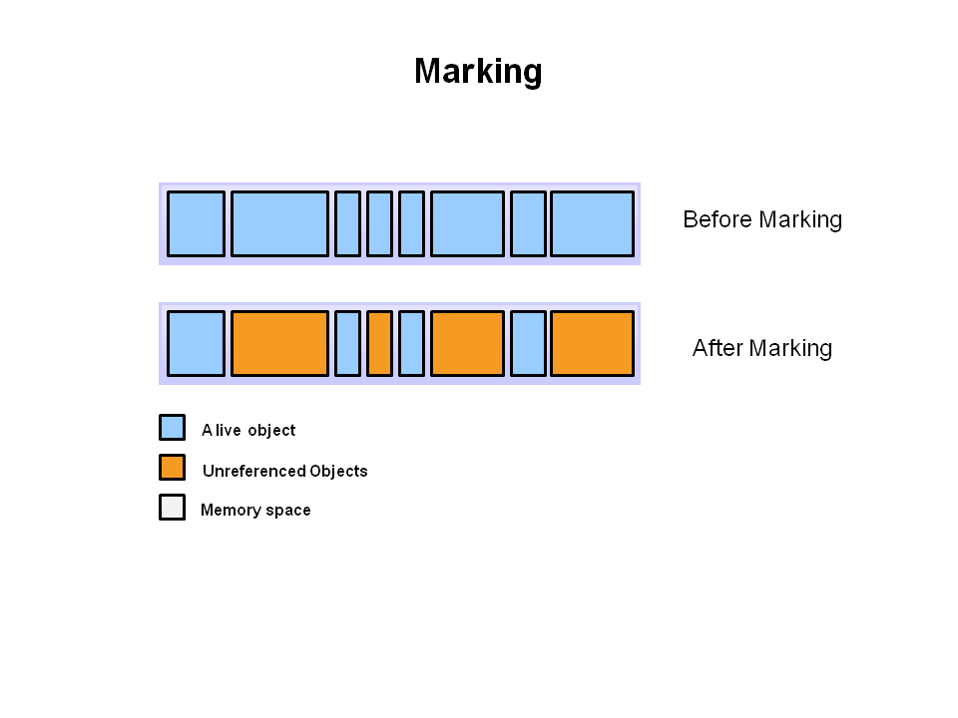
Step 1 : Mark
The first step in the process is called marking.
This is where garbage collector identifies which pieces of memory are in use and which are not
All objects are scanned in the marking phase to make this determination.
This can be a very time-consuming process if all objects in a system must be scanned.

Slide 72
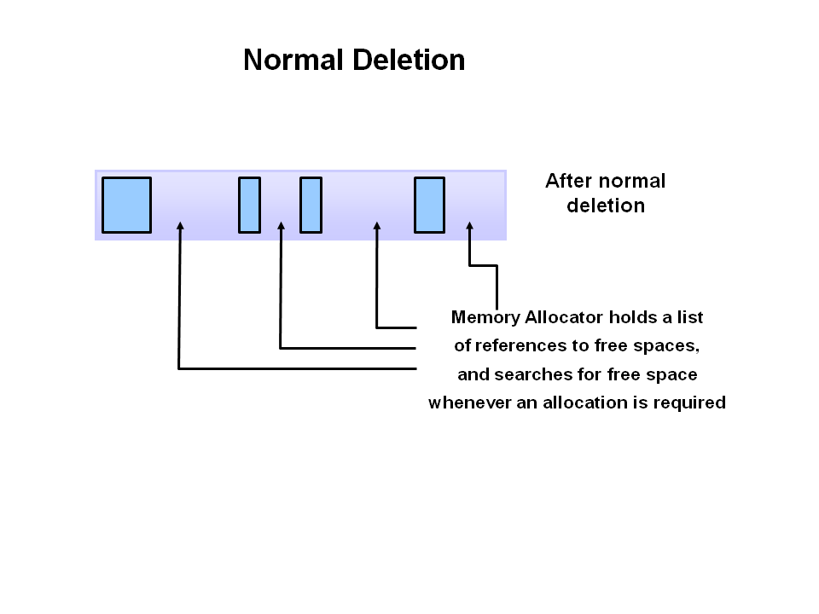
Step 2 : Normal Deletion - Sweeping
Normal deletion removes unreferenced objects leaving referenced objects and pointers to free space.
The memory allocator holds references to the block of free space where new object can be allocated.

Slide 73
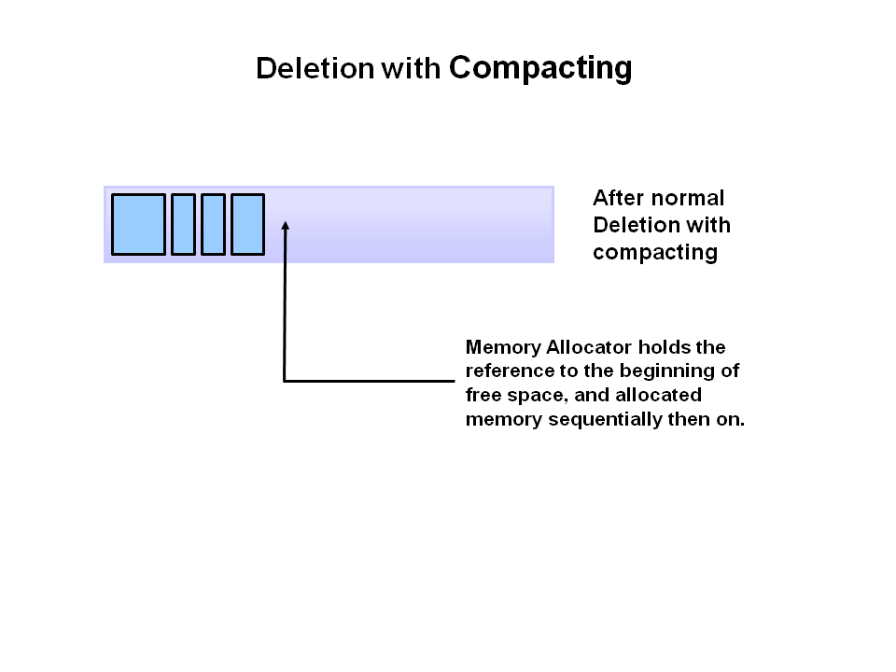
Step 3 - Deletion with Compacting - Compaction
To further improve performance, in addition deleting unreferenced object, you can also compact the remaining referenced objects.
By moving referenced object together, this makes new memory allocation much easier and faster

Slide 74
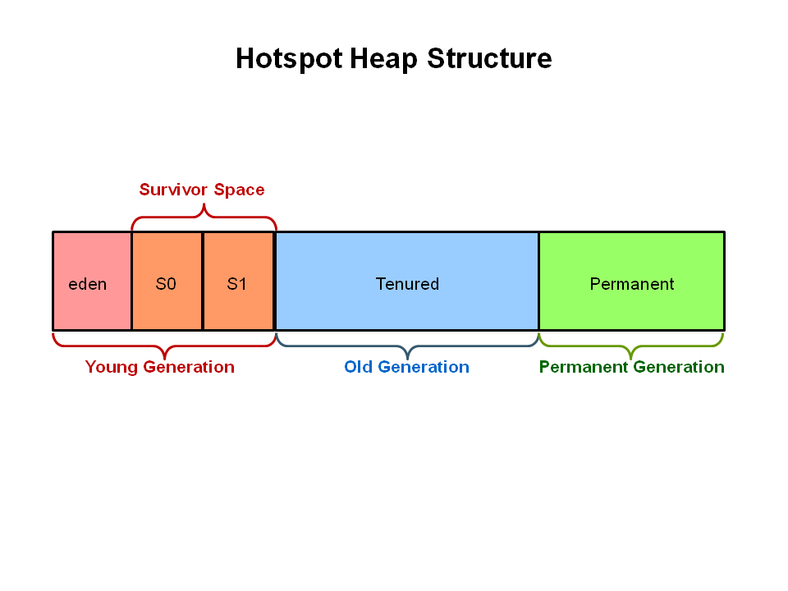
JVM Generations
The information learned from the object allocation behaviour can be used to enhance the performance of the JVM.
Therefor, the heap is broken up into smaller parts or generations.
The heap parts are
Young Generation
Old or Tenured Generation
Permanent Generation

Slide 75
Young Generation
The Young Generation is where all new objects are allocated and aged.
When young generation fills up, this causes a minor garbage collection.
Minor collections can be optimized assuming a high object mortality rate.
Some surviving objects are aged and eventually move to the old generation.

Slide 76
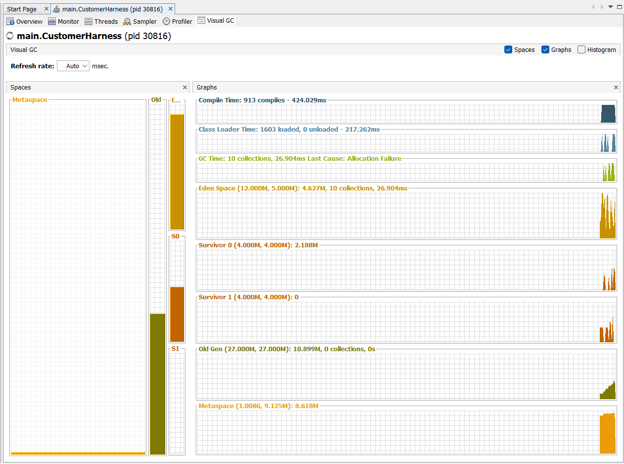
Viewing the generations in VisualVM

Slide 77
Types of Garbage Collectors in Java
Serial Garbage Collector
Single thread
Simple
Not for production
Parallel Garbage Collector (Throughput Collector)
Multi-threaded
Focus : high throughput
Higher pause times
CMS (Concurrent Mark-Sweep) Garbage Collector – Depricated
Runs with application
Low pause
Deprecated – replaced by G1

Slide 78
Types of Garbage Collectors in Java
G1 (Garbage First) Garbage Collector – Default
Region-based heap
Predictable pause time
G1 tries to clean only the dirty parts, not the whole heap
Z Garbage Collector (ZGC)
Ultra low latency
Scales to huge heaps
Shenandoah Garbage Collection – Linux Only
Similar to ZGC
Concurrent compaction

Slide 79
Quick Comparison Table
GC | Goal | Pause | Use Case
Serial | Simplicity | High | Small apps
Parallel | Throughput | Medium | Batch
G1 | Balanced | Low | Default
ZGC | Ultra low latency | Very Low | Real-time
Shenandoah | Low latency | Very Low | Large heaps

Slide 80
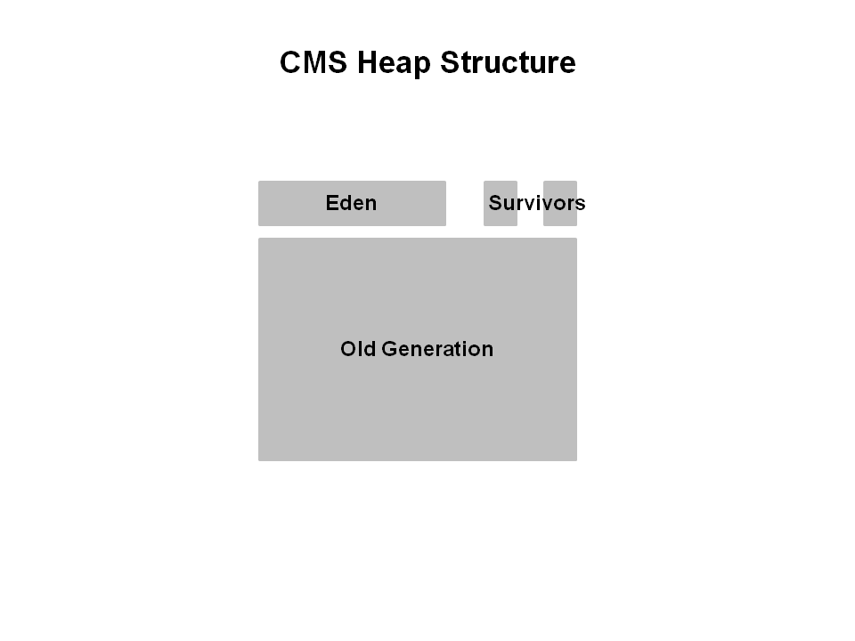
Reviewing Generational GC - CMS
Heap Structure for CMS Collector
The heap is split into three spaces.
Eden
Old Generation
Survivors
Young generation is split into Eden and two survivor spaces.
Old generation is one contiguous space. Object collection is done in place.
No compaction is done unless there is a full GC – major GC.

Slide 81
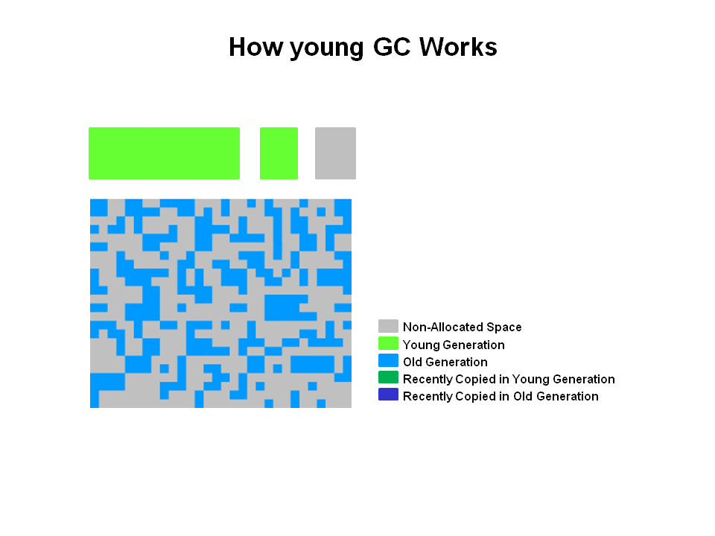
How Young GC work in CMS
The young generation is coloured light green and the old generation in blue.
This is what the CMS might look like if your application has been running for a while.
Objects are scattered around the old generation area.
With CMS, old generation objects are deallocated in place.
They are not moved around. The space is not compacted unless the is a full GC.

Slide 82
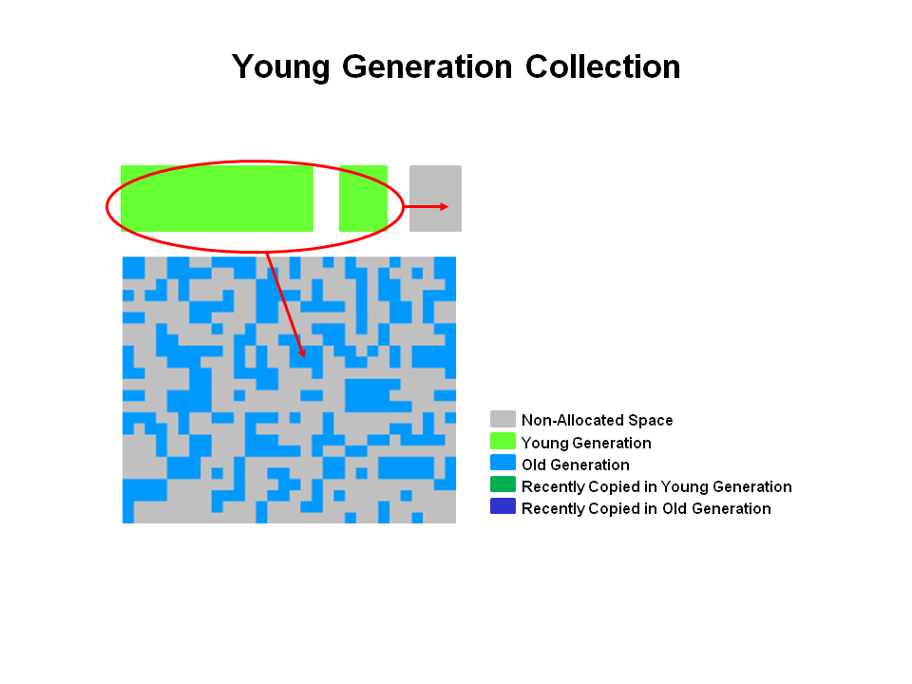
Young Generation Collection : CMS
Live objects are copied from the Eden space and Survivor space.
Any older objects that have reached their aging threshold are promoted to old generation.

Slide 83
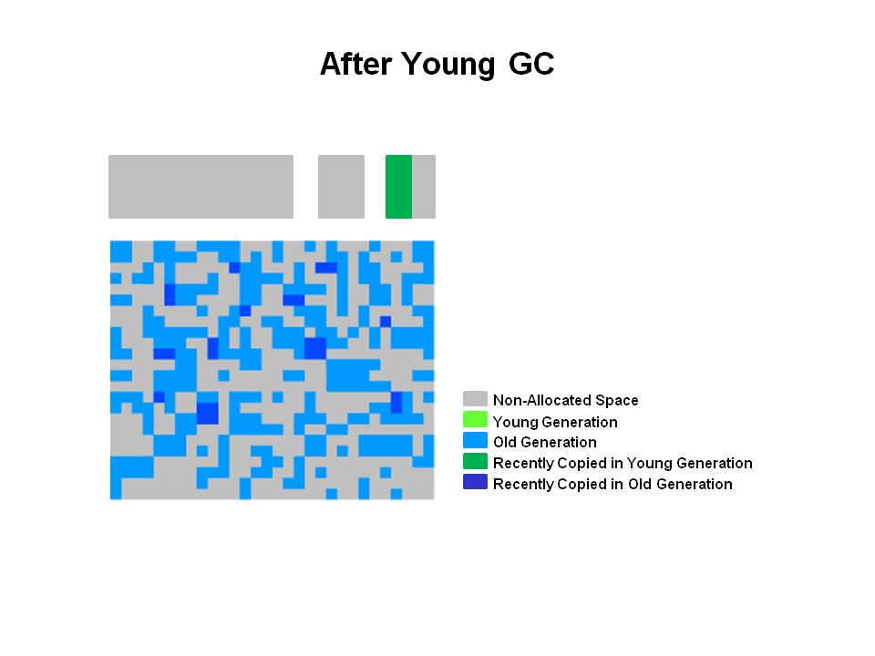
After Young GC : CMS
After a young GC, the Eden space is cleared and one of the survivor spaces is cleared.
Newly promoted objects are shown in dark blue on the diagram.
The green object are surviving young generation objects that have not yet been promoted to old generation.

Slide 84
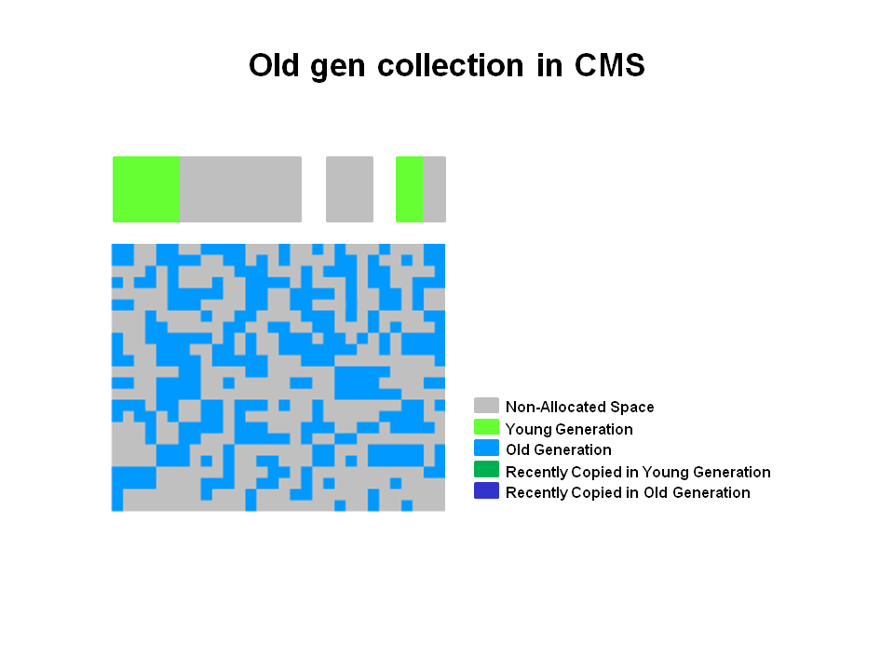
Old Generation Collection with CMS
Two stop the world events take place
Initial mark
Remark
When old generation reaches a certain occupancy rate, the CMS is kicked off.
Initial mark is a short pause phase where live objects are marked.
Concurrent marking finds live objects while the application continue to execute.
In the remark phase objects are found that were missed during concurrent marking in the previous phase.

Slide 85
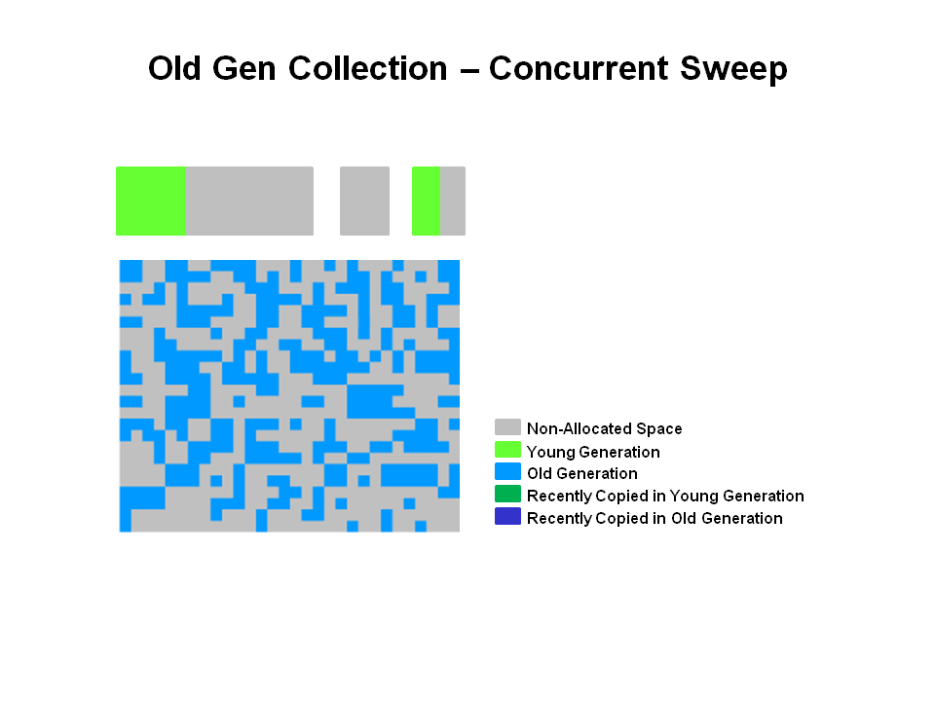
Old Generation Collection – Concurrent Sweep
Objects that were not marked in the previous phase are deallocated in place.
There is no compaction.
Unmarked objects = Dead objects

Slide 86
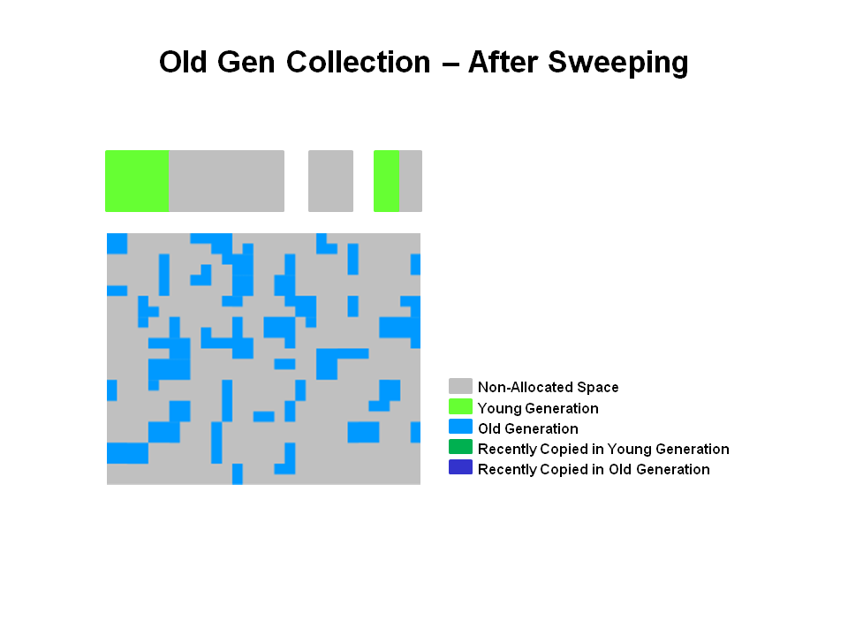
Old Generation Collection - After Sweeping
After the Sweeping phase, you can see that a lot of memory has been freed up. You will also notice that no compaction has been done.
Finally, the CMS collector will move through the resetting phase and wait for the next time GC threshold is reached.

Slide 87
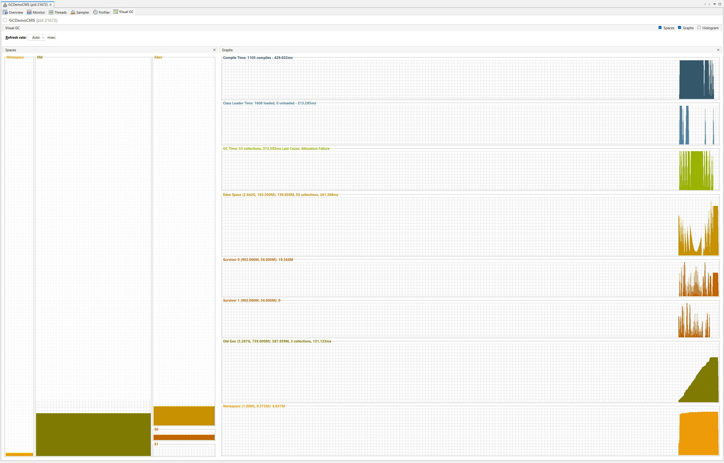
CMS GC – In VisualVM and VisualGC

Slide 88
G1 Garbage Collector Overview
What is G1 GC ?
Server-style garbage collector for large heap, multi-processor systems
Designed for high throughput + predictable pause times
Fully supported from JDK 9

Slide 89
G1 Garbage Collector Overview
Key Features
Works concurrently with application threads (like CMS)
Provides predictable GC pause times
Performs heap compaction (avoids fragmentation)
Maintains high performance (throughput)

Slide 90

G1 Operational Overview
The older garbage collectors (serial, parallel, CMS) all structure the heap into three sections.
Young Generation
Old Generation
Permanent Generation
All memory objects end up in one of these three sections.

Slide 91
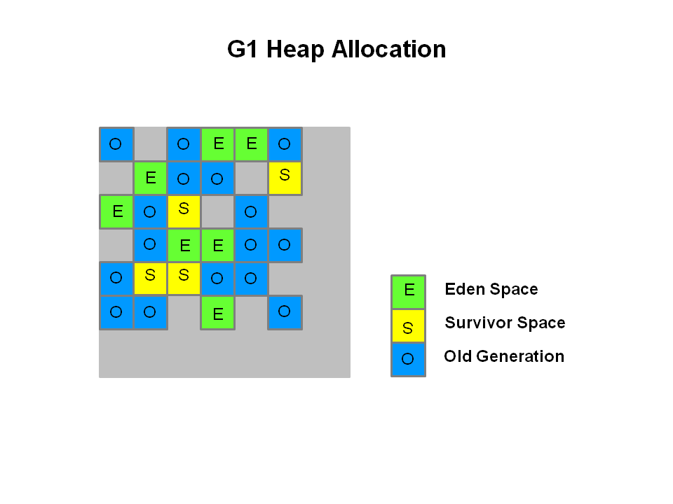
G1 Operational Overview
The heap is partitioned into set of equal-size heap regions, each a contiguous range of virtual memory.
Certain region sets are assigned the same roles (eden, survivor, old) as in the older collectors, but there is not a fixed size for them.
This provides greater flexibility in memory usage.

Slide 92
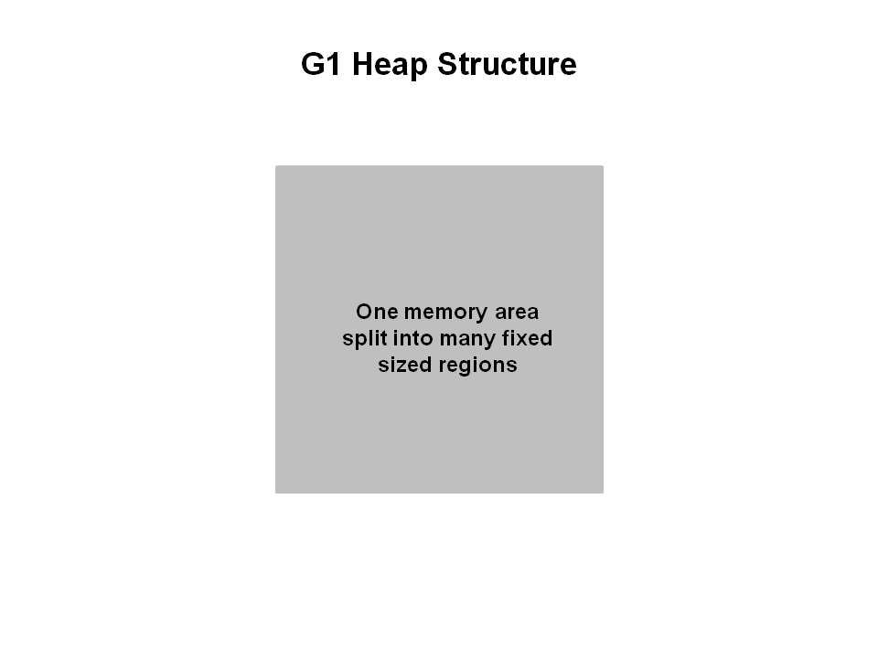
The G1 Garbage Collector Step by Step
The G1 collector takes a different approach to allocating the heap.
The heap is one memory area split into many fixed sized regions.
Region size is chosen by the JVM at startup.
The JVM generally targets around 2000 regions varying the size from 1 to 32Mb

Slide 93
G1 Heap Application
In reality, these regions are mapped into logical representations of Eden, Survivor and old generation spaces.
The colours in the picture shows which region is associated with which role.
Live objects are evacuated (i.e. copied or moved) from one region to another.
Regions are designated to be collected in parallel with or without stopping all other application threads.

Slide 94
G1 Heap Application
As shown regions can be allocated into Eden, Survivor and old generation regions.
In addition, there is a fourth type of object known as Humongous regions.
These regions are designed to hold objects that are 50% the size of a standard region or larger.
They are stored as a set of contiguous regions.
Finally, the last type of regions would be the unused areas of the heap.
At the time of this writing, collecting humongous objects has not been optimized.
Therefor, you should avoid creating objects of this size.

Slide 95
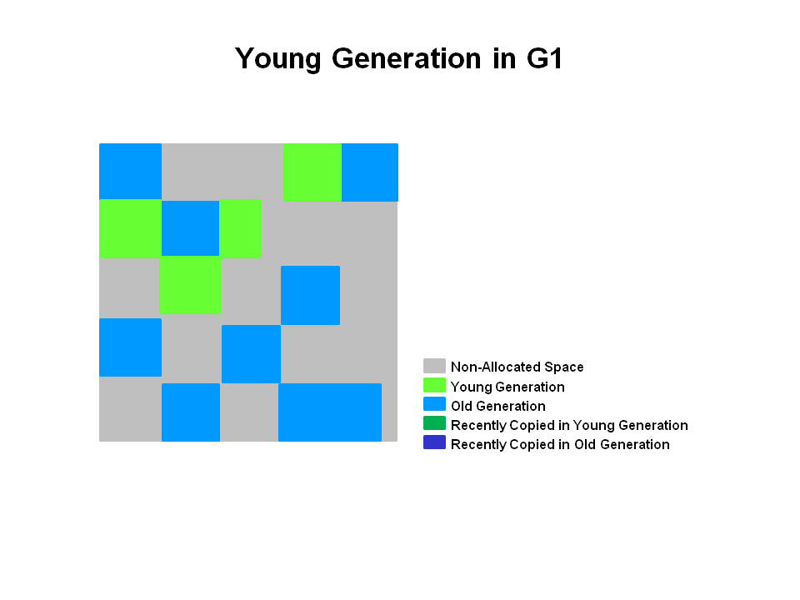
Young Generation in G1
The Heap is split into approximately 2000 regions.
Minimum size is 1 Mb and Maximum is 32 Mb.
Blue regions hold the old generation objects and green regions hold young generation objects.
Note that the regions are not required to be contiguous like older garbage collectors.

Slide 96
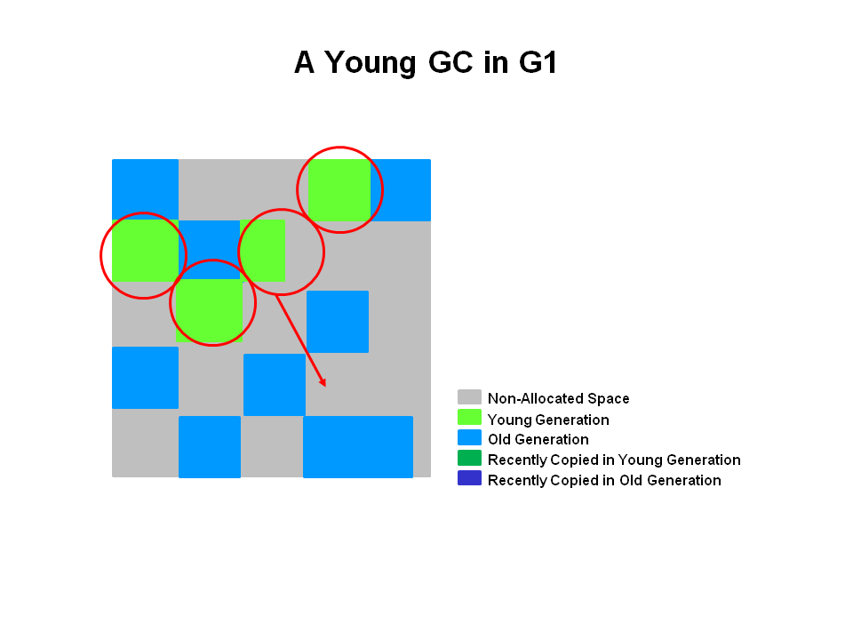
A Young GC in G1
Live objects are evacuated(i.e. copied or moved) to one or more survivor regions.
If the aging threshold is met some of the objects are promoted to old generation regions.
This is a stop the world pause.
Eden size and survivor size is calculated for next young GC.
Accounting information is kept to help calculate the size .
Things like pause time goal are taken into consideration.
This approach makes it vary easy to resize region, making them bigger or smaller as needed.

Slide 97
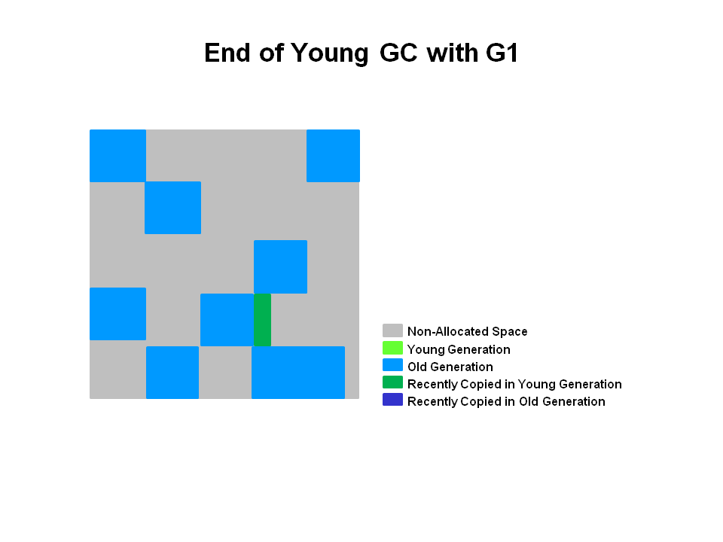
End of a Young GC with G1
Live objects have been evacuated to survivor regions or to old generation regions.

Slide 98
End of a Young GC with G1
The heap is a single memory space split into regions.
Young generation memory is composed of a set of non-contiguous regions.
This makes it eazy to resize when needed.
Young generation garbage collections or young GC are the stop the world events. All application threads are stopped for the operation.
The young GC is done in parallel using multiple threads.
Live objects are copied to new survivor or old generation regions.

Slide 99
Summary
The following can be said about the young generation in G1
The heap is a single memory space split into regions.
Young generation memory is composed of a set of non-contiguous regions.
This makes it easy to resize when needed.
Young generation garbage collections, or young GCs are stop the world events.
All application threads are stopped for the operation
The young GC is done in parallel using multiple threads.
Live objects are copied to new survivor or old generation regions

Slide 100
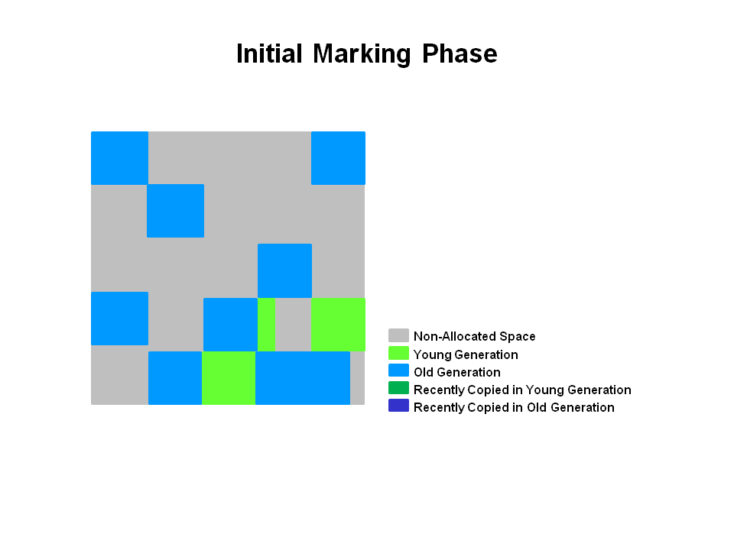
Initial Marking Phase – Stop The World
Marks objects directly reachable from GC Roots(Object Reachability)
Very short pause

Slide 101
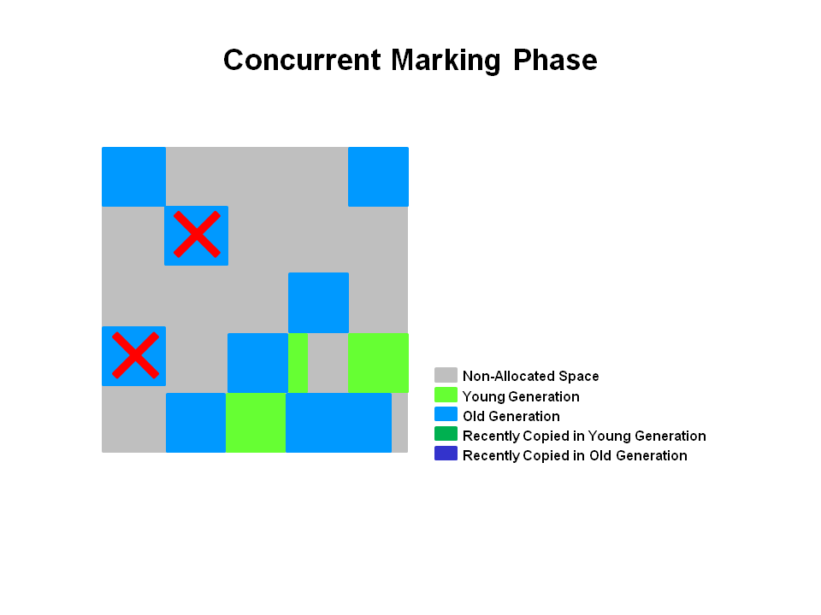
Concurrent Marking Phase
Runs in parallel with application threads
If empty regions are found (as denoted by the "X"),
They are removed immediately in the Remark phase.

Slide 102
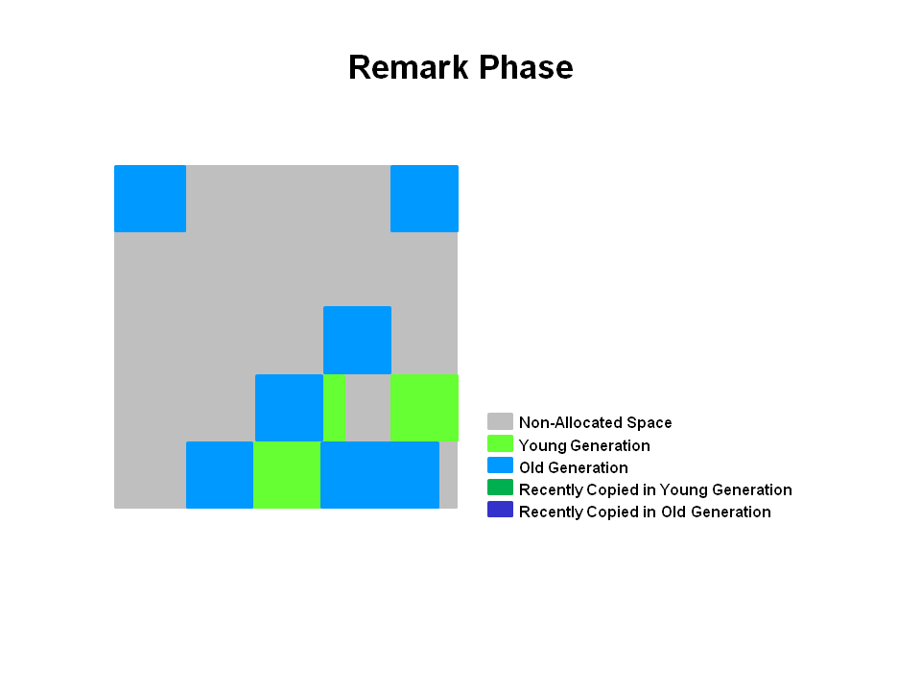
Remark Phase – Stop The World
Empty regions are removed and reclaimed.
Regions liveness is now calculated for all regions.
Final cleanup of missed objects (due to concurrent changes)

Slide 103
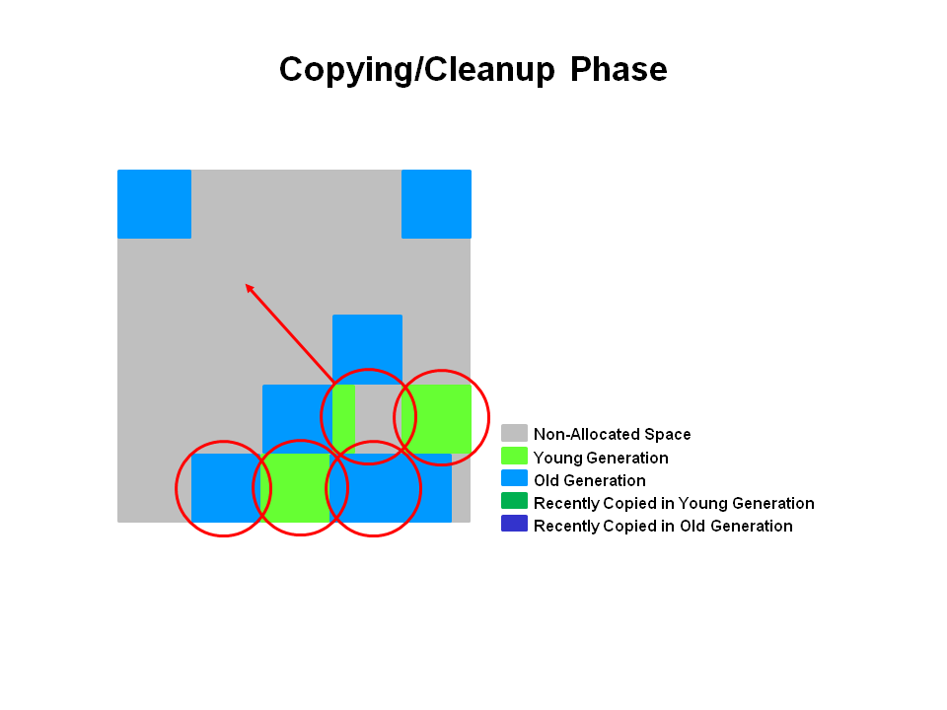
Copying/Cleanup Phase
Identify empty regions and prepare for evacuation.
G1 selects the regions with the lowest “liveness”, those regions which can be collected the fastest.
Then those regions are collected at the same time as young GC.
This denoted in logs as [GC pause (mixed)]
So both young and old generations are collected at same time.

Slide 104
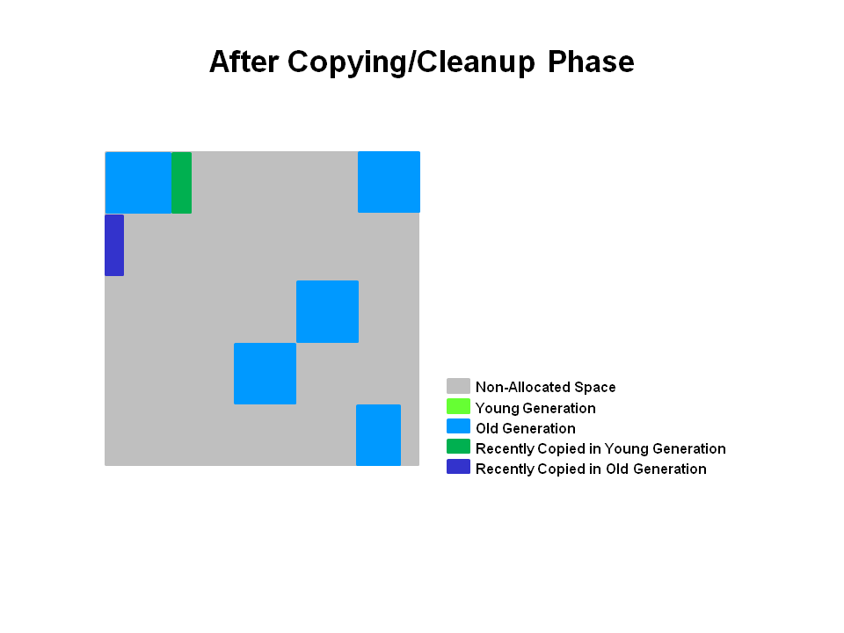
After Copying/Cleanup Phase
This regions selected have been collected and compacted into dark blue region and dark green region shown in diagram

Slide 105
Summary
Following are a few key points we can make about the G1 garbage collection on the old generation
Concurrent Marking Phase
Liveness information is calculated concurrently while application is running
This liveness information identifies which regions will be best to reclaim during an evacuation pause.
There is no sweeping phase like in CMS
Remark Phase
Uses the Snapshot-at-the-Beginning algorithm which is much faster than what was used with CMS.
Completely empty regions are reclaimed.
Copying/Cleanup Phase
Young generation and old generation are reclaimed at the same time
Old generation regions are selected based on their liveness

Slide 106
G1 Garbage Collector Overview
Why G1 is better than CMS ?
Compacting collector – eliminates fragmentation
Uses regions instead of free lists – simpler memory management
Offers predictable pause time goals
Reduce long GC pauses

Slide 107
Code Example
public static void main(String[] args) throws InterruptedException {
List<byte[]> memoryConsumer = new ArrayList<>();
for (int i = 0; i < 1000; i++) {
// Allocate 1MB objects
byte[] block = new byte[256 * 1024];
memoryConsumer.add(block);
if (i % 10 == 0) {
System.out.println("Allocated " + (i + 1) + " MB");
Thread.sleep(100);
}
}
System.out.println("Finished allocation");
}

Slide 108
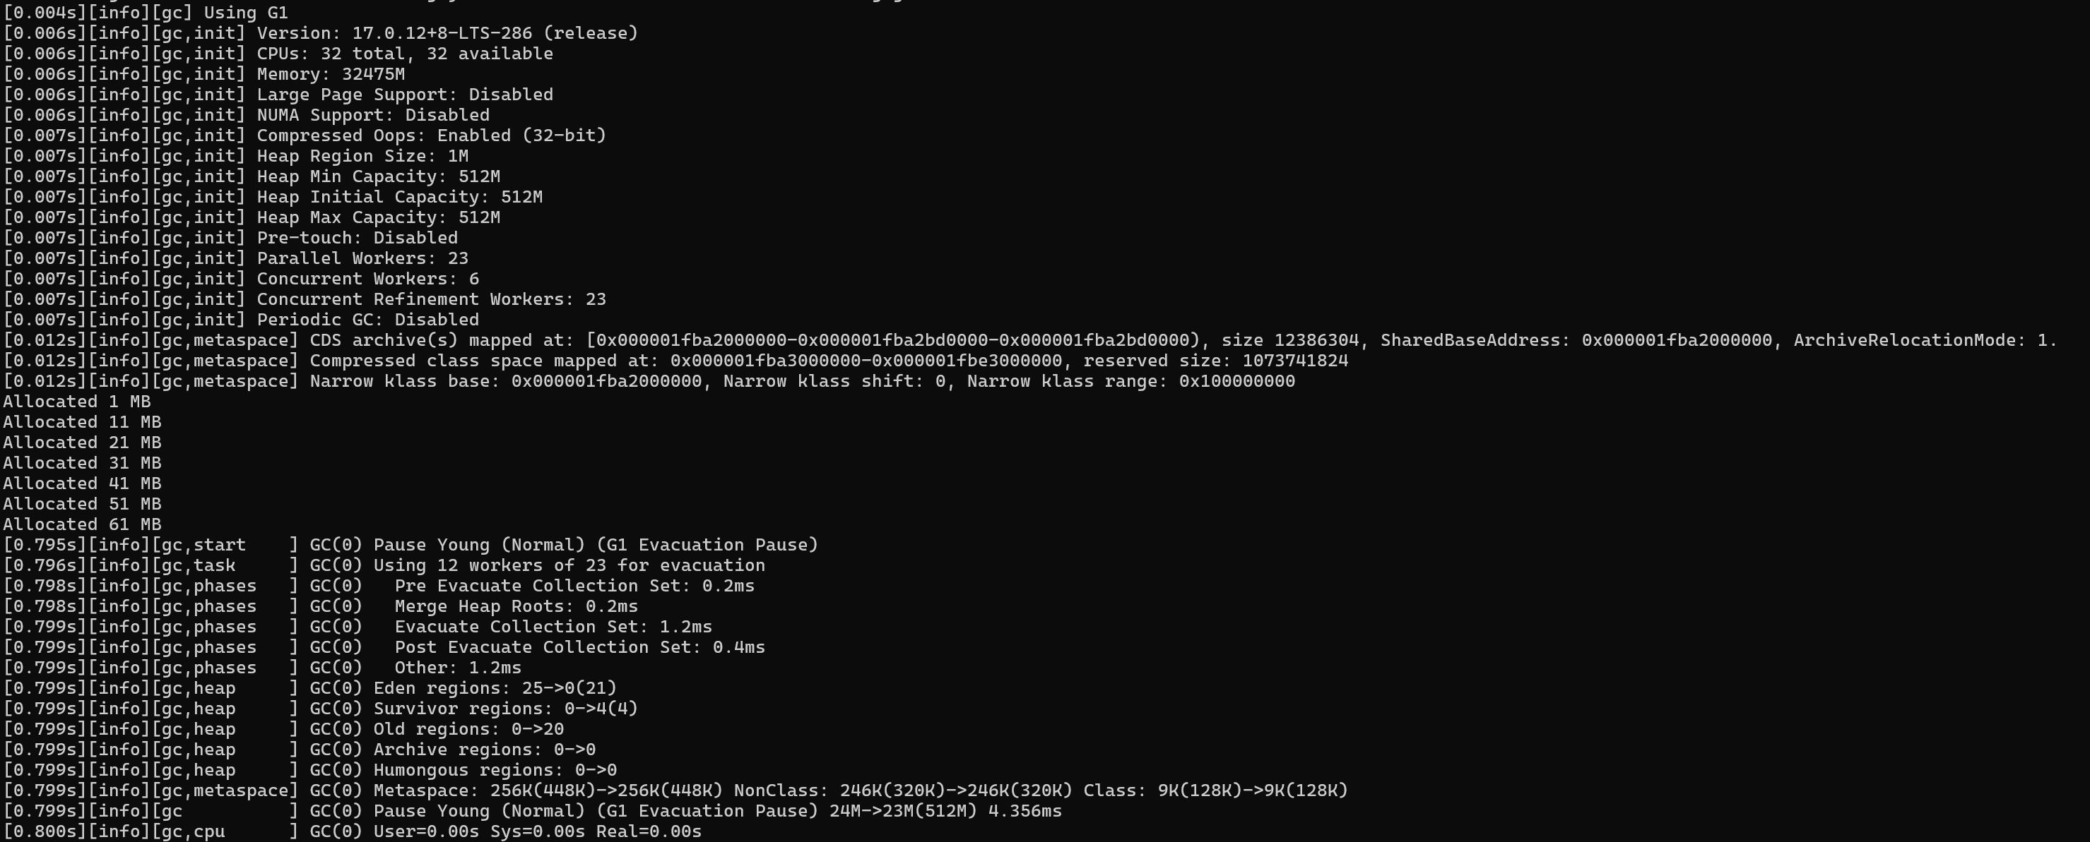
GC Logs

Slide 109
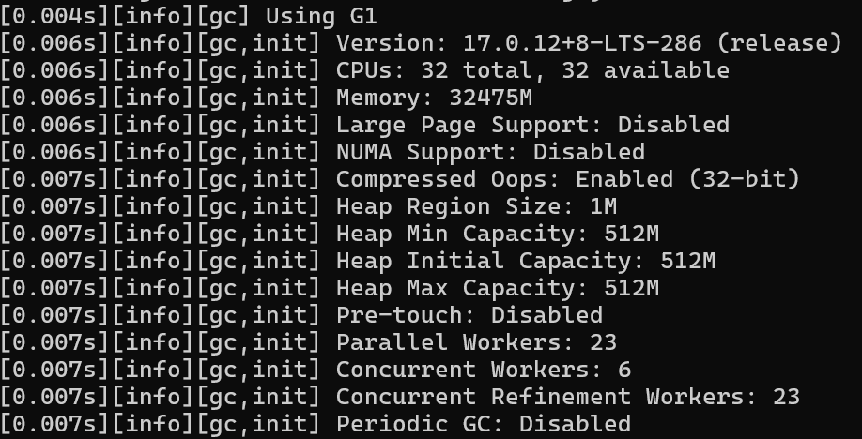
1. JVM Startup – System is Ready
JVM is using G1 Garbage Collector
Heap is divided into 1MB regions
Total heap = 512MB = 512 regions

Slide 110
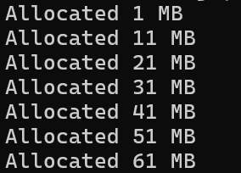
Your Program Starts Allocating Memory
Creating objects
Storing in list(*)
Memory keeps increasing
* = These objects are not garbage because you are storing them.
// Allocate memory
byte[] block = new byte[256 * 1024];
memoryConsumer.add(block);

Slide 111
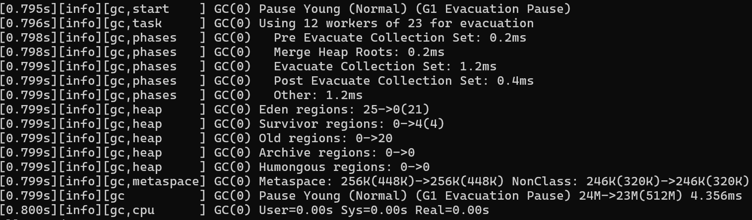
First GC Happens – GC(0)
Young GC triggered
JVM pauses briefly – few ms
What happens inside GC(0)
Eden Full
25 regions were full
New objects were sitting here
GC Cleans Eden
Eden cleared completely
Live Objects Moved
Some objects to Survivor
Some object to Old
GC Pause Time
Application paused only 4 ms
Low pause time

Slide 112

Second GC GC(1)
What changed
Eden cleaned again
Survivor stayed same
Objects still alive
Old increased
More objects promoted

Slide 113
Pattern you should notice
Across GCs
Objects are not dying
They survive multiple GCs
Eventually move to Old generation
Evacuation Pause
JVM copies live objects
From
Eden to Survivor
Survivor to Old
GC Workers
GC is parallel
Multiple threads cleaning memory

Slide 114
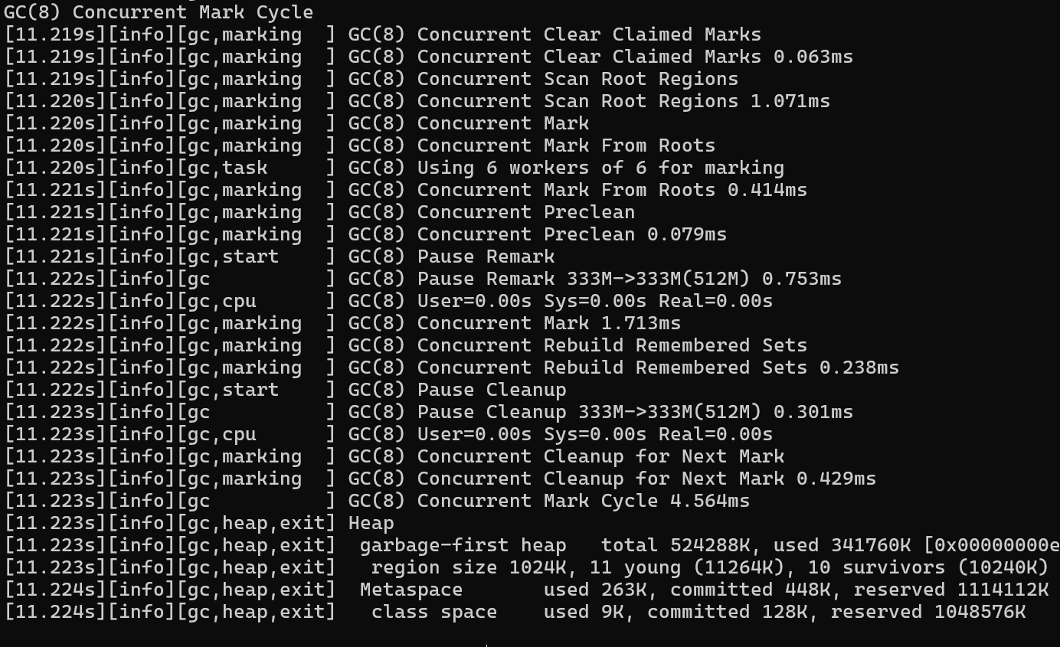
Concurrent Mark Cycle
Cycle Starts
G1 has started analysing Old generation
Goal : find live vs garbage objects
Clear Previous Marks
Resetting old marking data
Preparing for fresh analysis
Scan Root Regions
Root references stack, static vars
Main Phase – Concurrent Mark
Runs in background
Uses multiple threads (6 workers)
Traverses object graph
All reachable – live objects

Slide 115
Concurrent Mark Cycle
Preclean Phase
Clean small changes
Reduce work for next pause
Remark Phase – Stop The World
JVM pauses application briefly
Fixes changes that happened during marking
As app was running during marking
Object references may have changed
It’s a final correction before finishing marking
Concurrent Mark Ends
Total marking work completed
Rebuild Remembered Sets
JVM updates Cross Region references
Needed for Efficient future GC

Slide 116
Concurrent Mark Cycle
Cleanup Phase ( Short Pause)
Identifies regions with garbage
Decides which regions to clean later
Concurrent Cleanup
Background Cleanup for GC cycle
Cycle Ends
4.5 ms – Very fast
Final Heap Status
Heap = 512 MB
341MB used
No memory reclaimed

Slide 117
Observations
Memory did not reduce
Objects are still referenced
All objects are live NOT garbage
So
Marking works
Cleanup possible
But nothing to delete

Slide 118
Updated Code with GC
public static void main(String[] args) throws InterruptedException {
List<byte[]> longLived = new ArrayList<>();
for (int i = 0; i < 1000; i++) {
List<byte[]> temp = new ArrayList<>();
for (int j = 0; j < 50; j++) {
temp.add(new byte[256 * 1024]); // short-lived
}
// Some objects live longer
if (i % 5 == 0) {
longLived.add(new byte[256 * 1024]);
}
temp = null;
System.out.println("Cycle " + i);
Thread.sleep(100);
}
}

Slide 119

Observation 1. GC is actually working
Before GC – heap full
After GC – heap drops drastically, objects became unreachable – GC reclaimed memory

Slide 120
2. What Your Program is Doing (Correct Behaviour)
Each Cycle
Create objects approx. 300 MB
Remove references ( temp = null)
GC runs
Memory cleaned
That’s why we see

Slide 121
3. Young GC Pattern – Perfect Example
Eden fills up
GC runs
Eden cleared completely

Slide 122
4. Memory Reclamation
Garbage is being created
GC is reclaiming it
Heap is not leaking

Slide 123
5. Why Memory Drops So Much ?
Objects become reachable (temp = null)
Objects become eligible for GC (GC only removes unreachable objects)

Slide 124
6. Survivor Space Behavior
Some objects survive briefly
Move to survivor
Then either Dir or get promoted

Slide 125
7. Old Generation Growth (Slow & Healthy)
Important Observation:
Growth is slow
Not exploding like previous example
Why
Because most objects die young
Only few survive long enough
This is called Generation Hypothesis

Slide 126
8. GC Efficiency
Look at pause times
Low latency
Consistent performance
G1 working as designed

Slide 127
9. No Humongous Objects
No special case allocation
Clean G1 flow

Slide 128
11. Final Heap State
Some objects still alive
JVM stable
No memory pressure

Slide 129
G1 provides predictable pause time
We say G1 provides predictable pause times because it is designed around a pause-time goal and uses smart heuristics to control how much work it does in each pause.

Slide 130
G1 provides predictable pause time
Pause time goal – User Controlled
You can define a target -XX:MaxGCPauseMillis=200
This does NOT guarantee, but G1 tries to meet it consistently
G1 plans GC work based on this goal
Region-Based Collection (Key Reason)
Heap is split into small regions (1–32 MB)
Instead of collecting entire generations:
G1 collects only selected regions
Smaller work = more controllable pause time
Garbage-First Selection (Priority-Based)
G1 tracks live data and Garbage % in each region
It selects regions with Maximum garbage and Minimum live data
More memory reclaimed with less task – shorter pauses

Slide 131
G1 provides predictable pause time
Predictive Cost Model (Core Magic)
G1 maintains historical data like:
Time to scan a region
Time to copy objects
Object survival rates
Incremental Work (Not all at once)
Old generation is NOT collected fully in one go
Done via Mixed GCs
Avoid full GC pauses

Slide 132
G1 provides predictable pause time
Concurrent Work Reduces STW
Most heavy work like marking live objects and region analysis runs in background
Stop the world phases are short and controlled
Note : G1 gives predictability, not guarantee
Consistent pauses (e.g., 100–250 ms range)
Not strict real-time (can exceed target sometimes)

Slide 133
G1 Garbage Collector Tuning Parameters
Flag | Purpose
-Xms512m | Initial heap
-Xmx512m | Max heap
-XX:+UseG1GC | Use G1 collector
-Xlog:gc* | Enable GC logs
-XX:MaxGCPauseMillis=50 | Target Pause Time
-XX:G1HeapRegionSize=2m | Region Size
-XX:InitiatingHeapOccupancyPercent=45 | Concurrent Mark Cycle
-XX:+ParallelRefProcEnabled | Processes Parallel
-XX:ConcGCThreads=4 | Threads used for concurrent marking – CPU Based
-XX:ParallelGCThreads=8 | Threads used for Stop the world phases – CPU Based
-XX:+HeapDumpOnOutOfMemoryError | Dumps heap to file

Slide 134
MCQ
1. Which is the correct sequence of major G1 GC phases?
Young GC → Full GC → Mixed GC
Initial Mark → Concurrent Mark → Remark → Cleanup
Mark → Sweep → Compact
Eden → Survivor → Old
Correct Answer: B Explanation: G1 follows a marking cycle: Initial Mark → Concurrent Mark → Remark → Cleanup.
2. What happens during the “Initial Mark” phase in G1 GC?
Entire heap is scanned
Only survivor regions are cleaned
Objects directly reachable from GC roots are marked
Heap is compacted
Correct Answer: C Explanation: Initial Mark identifies objects directly reachable from GC roots (usually STW but short).

Slide 135
MCQ
3. What is special about the “Concurrent Mark” phase?
Runs only during Full GC
Runs in parallel with application threads
Stops all application threads
Cleans only young generation
Correct Answer: B Explanation: This phase runs concurrently with the application to reduce pause times.
4. Why is the “Remark” phase required in G1 GC?
To allocate new objects
To finalize marking and catch changes during concurrent phase
To compact entire heap
To clean only Eden space
Correct Answer: B Explanation: It corrects any changes made by application threads during concurrent marking.

Slide 136
MCQ
5. What is the purpose of the “Cleanup” phase?
Move objects between threads
Identify empty regions and prepare for evacuation
Stop application completely
Allocate new heap
Correct Answer: B Explanation: Cleanup identifies unused regions and helps plan future collections.

Slide 137
Session 5 : Profiling & Application Diagnostics
Session Objective
Understand how to analyse performance issue using profiles
Identify CPU hotspots and bottlenecks
Detect memory leaks using heap analysis
Analyse threads states, deadlocks and contention
Diagnose I/O and latency issues
Use tools like JFR, JMC, VisualVM, jstack

Slide 138
What is Profiling ?
Application is slow… Where is the problem ?
Code ?
GC ?
Threads ?
Database ?
Profiling = Finding truth using data
Profiling = Measuring runtime behaviour
Removes guesswork
Without profiling, performance tuning is just guessing

Slide 139
Types of Profiling
CPU Profiling
Finds hot methods
Answers : which method is consuming time
Memory Profiling
Detects memory leaks and large objects
Why memory is not getting freed ?
Thread Profiling
Detects Deadlocks, Blocking, Contention
I/O Profiling
Detects DB latency
API delays
Answers : Why app is slow but CPU is low ?

Slide 140
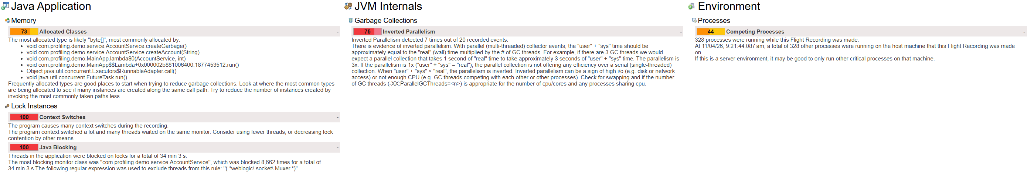
Observations in JMC
Memory: Allocated Classes
Most allocated type : byte []
Coming from AccountService.createGarbage() and createAccount()
What it means
Your application is creating too many objects
High allocation rate which leads to GC pressure
Problem
Excessive memory churn
Increased GC frequency
Performance degradation
This tells us the application is allocating too many objects, especially byte arrays — a classic cause of GC overhead

Slide 141
Observations in JMC
Lock Instances : Context Switches
Score: 100 (Critical)
Many context switches
What it means
Threads frequently switching CPU
Caused by
Lock contention
Too many threads
Problem
CPU wasting time switching threads instead of doing work
High context switching means threads are fighting for CPU — this is inefficiency, not productivity.

Slide 142
Observations in JMC
Lock Instances : Java Blocking
Threads blocked
What it means
Threads are waiting on locks - synchronized
Problem
Severe scalability issue
System behaves like single-threadedThreads blocked
Even though we created multiple threads, synchronization forced them to wait — killing parallelism.

Slide 143
Observations in JMC
JVM Internals: GC (Inverted Parallelism)
Inverted Parallelism
Score : 75
What it means
GC threads competing with each other
Not enough CPU available
Problem
GC is inefficient
Application _ GC both fighting for CPU
Instead of speeding up GC, multiple GC threads are slowing each other down — a sign of CPU contention.

Slide 144
Profiling Key Takeaways
Avoid unnecessary object creation
Minimize synchronization
Monitor GC behavior
Don’t overuse threads
Always profile before optimizing

Slide 145
Day 2 : Session 1 : Code-Level Performance Optimization
Session Objective
Understand how application code directly impacts performance, often more than JVM tuning
Identify hidden inefficiencies in everyday coding practices (collections, strings, synchronization, streams)
Learn how to choose the right data structures and algorithms for optimal performance
Recognize and eliminate common performance anti-patterns used in real-world applications
Measure and compare performance using basic benchmarking and profiling tools (JFR/JMC)

Slide 146
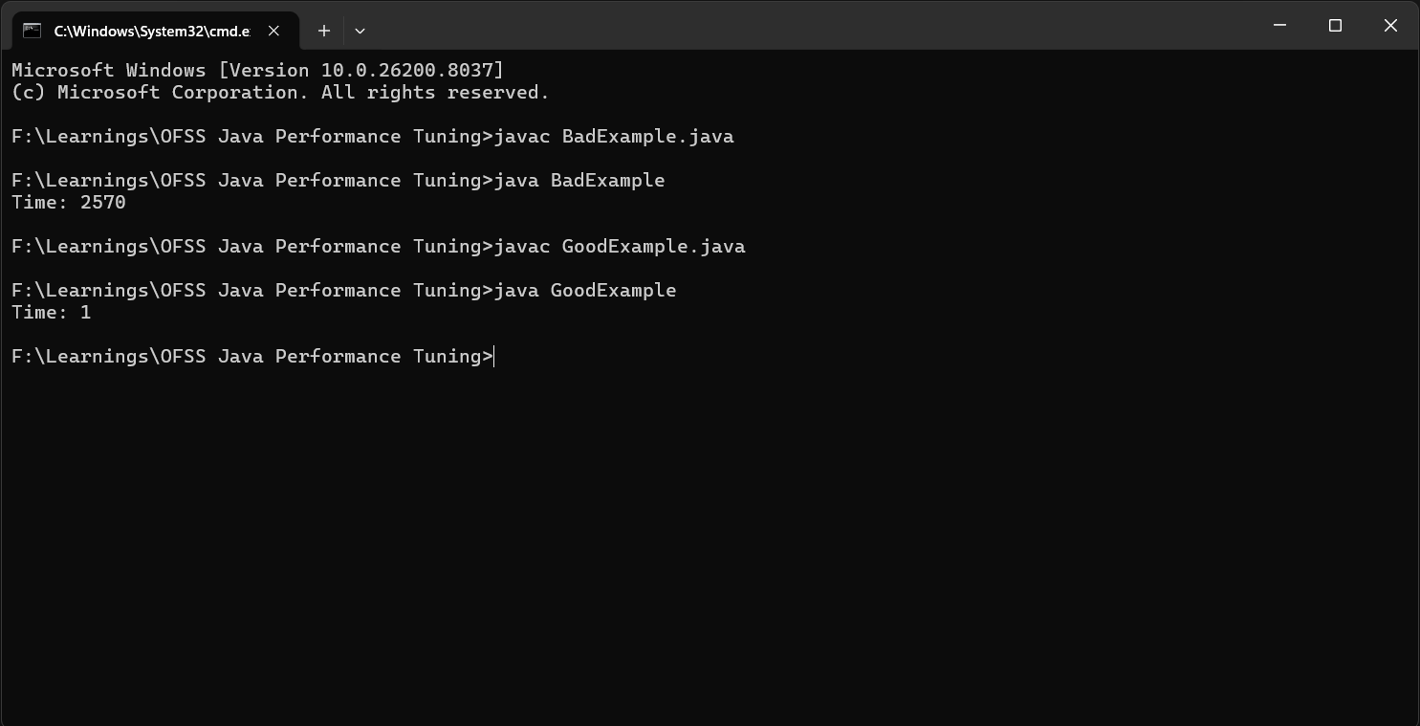
Efficient Data Structures
Key Idea
Choosing wrong data structure = hidden performance bug.
Data Structures
ArrayList – Fast reads, slow inserts in middle
LinkedList – Slow traversal
HashMap – O(1) average, but hashing cost matters
ConcurrentHashMap – Better for multi-threading

Slide 147
Example : Incorrect Data Structure
import java.util.*;
public class BadExample {
public static void main(String[] args) {
List<Integer> list = new LinkedList<>();
// Insert elements
for (int i = 0; i < 100000; i++) {
list.add(i);
}
long start = System.currentTimeMillis();
// Frequent random access
for (int i = 0; i < list.size(); i++) {
list.get(i); // VERY SLOW in LinkedList
}
System.out.println("Time: " + (System.currentTimeMillis() - start));
}
}

Slide 148
Example : Correct Data Structure
import java.util.*;
public class GoodExample {
public static void main(String[] args) {
List<Integer> list = new ArrayList<>();
for (int i = 0; i < 100000; i++) {
list.add(i);
}
long start = System.currentTimeMillis();
for (int i = 0; i < list.size(); i++) {
list.get(i); // FAST (O(1))
}
System.out.println("Time: " + (System.currentTimeMillis() - start));
}
}

Slide 149
Cost of Synchronization
Why bad ?
Thread blocking
Context switching
Reduced CPU utilization
Better
Use fine-grained locks
Use Concurrent collections
Use Atomic classes

Slide 150
String Handling Optimization
Strings are immutable – creates thousands of objects
Bad
String result = "";
for (int i = 0; i < 10000; i++) {
result += i;
}
Good
StringBuilder sb = new StringBuilder();
for (int i = 0; i < 10000; i++) {
sb.append(i);
}

Slide 151
Collections Tuning
HashMap vs ConcurrentHashMap
Feature | HashMap | ConcurrentHashMap
Thread-safe | ❌ | ✅
Performance | Fast | Slight overhead
Locking | None | Segment/lock-free
ArrayList vs LinkedList
Operation | ArrayList | LinkedList
Access | ✅ Fast | ❌ Slow
Insert middle | ❌ | ❌ (still slow in real)
Memory | Compact | Heavy

Slide 152
Streams vs loops performance
Aspect | Loops (for/while) | Streams
Performance | ✅ Faster (generally) | ❌ Slight overhead
Readability | ❌ Verbose | ✅ Clean & declarative
Parallelism | ❌ Manual | ✅ Built-in (parallelStream)
Debugging | ✅ Easy | ❌ Harder
Memory | ✅ Less overhead | ❌ More object creation
Use loops for performance-critical code
Use streams for readability & maintainability

Slide 153
Why Streams are slower
Streams introduce hidden costs
Lambda overhead
Lambda = function object
Adds method calls and indirection
Internal Iteration
Streams use iterator + pipeline
Loops use simple index-based access
Object creation
Intermediate operation create objects
Especially costly in large datasets
Boxing/Unboxing
Streams may cause boxing overhead vs primitive loops

Slide 154
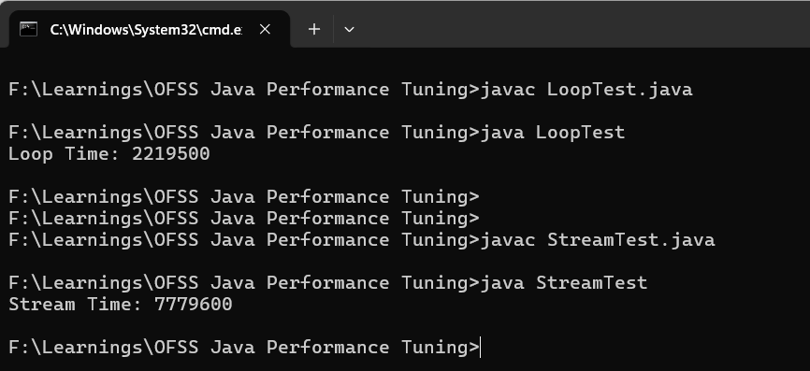
Example
Loop Version – Faster
long start = System.nanoTime();
int sum = 0;
for (int i = 0; i < list.size(); i++) {
sum += list.get(i);
}
long end = System.nanoTime();
System.out.println("Loop Time: " + (end - start));
Dataset Size | Loop | Stream
1K | Same | Same
1M | Faster | ~10–30% slower
10M | Much faster | Noticeable lag
Stream Version
long start = System.nanoTime();
int sum = list.stream().mapToInt(Integer::intValue).sum();
long end = System.nanoTime();
System.out.println("Stream Time: " + (end - start));

Slide 155
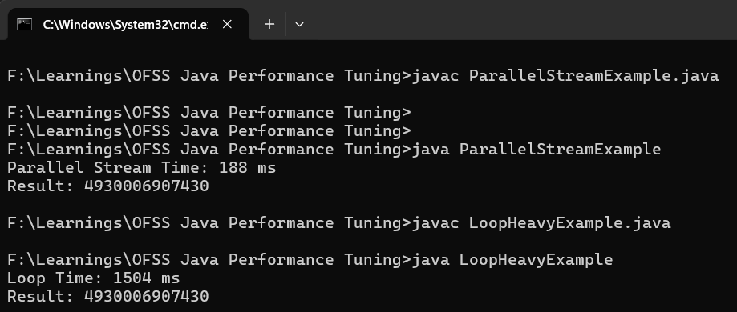
When Streams can be faster
Streams become faster when using parallelStream()
Conditions where it wins
Large dataset – millions of elements
CPU intensive operation – not just simple sum
Stateless operations – no shared mutable state
Multi-core CPU available
Work per element is heavy enough

Slide 156
Avoiding Anti-Patterns
Unnecessary boxing/unboxing
Inefficient use of streams
Heavy reflection use

Slide 157
Session 2 : Concurrency & Thread Optimization
Understand the cost of threads and context switching in Java
Learn how to use the Executor Framework to manage threads efficiently
Apply thread pool sizing strategies for CPU-bound and I/O-bound workloads
Explore advanced concurrency models like Fork/Join and Virtual Threads (Project Loom)
Identify and reduce contention, synchronization overhead, and false sharing
Gain practical skills to analyse and optimize multithreaded applications

Slide 158
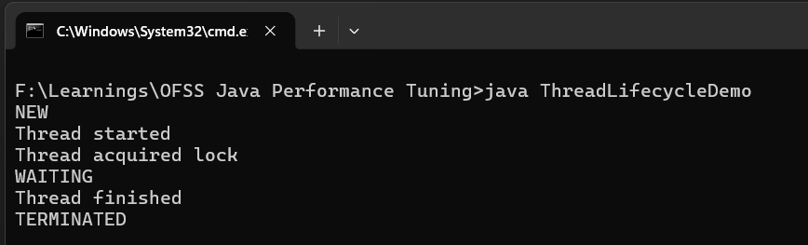
Thread Lifecycle & Scheduling Cost
Thread Lifecycle – A thread goes through
NEW – Created but not started
RUNNABLE – Ready/Running
BLOCKED – Waiting for monitor lock
WAITING/TIMED WAITING – Waiting for signal/sleep
TERMINATED

Slide 159
Thread Scheduling in Java
What is Scheduling ?
Thread scheduling is how the CPU decides which thread runs next.
Key Points
Controlled by OS scheduler, not by JVM fully
Java uses pre-emptive scheduling
Usage
Thread priority
Time slicing
CPU availability

Slide 160
Cost of Thread Scheduling : Context Switching Cost
Thread scheduling is not free – it has significant overhead
What happens ?
When CPU switches from Thread A to Thread B
Save current thread state in registers, stack
Load another thread state
Cost
1000s of CPU cycles
CPU cache get invalidated

Slide 161
Cost of Thread Scheduling : Lock Contention
If many threads
Compete for same lock
Threads go to BLOCKED STATES
Scheduler keeps switching
Cost
Increased latency
Reduced throughput

Slide 162
Cost of Thread Scheduling : Idle Waiting
Threads doing noting still
Occupy memory
Need scheduling and management

Slide 163
Solution
Bad Design
1000 threads
High context switching
CPU thrashing
Good Design
8-16 threads (based on CPU cores)
Stable throughput

Slide 164
Key takeaways
Thread Lifecycle
NEW → RUNNABLE → BLOCKED / WAITING → TERMINATED
Controlled via locks, wait/notify, sleep
Scheduling Cost
Context switching is expensive
Too many threads = performance degradation
Lock contention slows system
Best Practices
Use thread pools
Avoid unnecessary synchronization
Minimize thread creation

Slide 165
Executor framework tuning
Default thread pools often cause
Too many threads – context switching overload
Too few threads – underutilized CPU
Unbounded queue – memory issues / latency spikes
Wrong rejection policy – system instability
Proper tuning = optimal throughput + stable latency

Slide 166
Executor framework tuning
Key parameters to tune
Core Pool Size
Minimum threads always alive
Good for steady workload
Maximum Pool Size
Upper limit of threads
Used during peak load
Queue Type
Controls how tasks are buffered
Keep Alive Time
Idle threads above core size get terminated
Rejection Policy
When pool is full

Slide 167
Executor framework tuning
Aspect | Bad Config | Tuned Config
Queue | Unbounded | Bounded
Stability | ❌ Poor | ✅ Stable
Latency | ❌ Increasing | ✅ Controlled
Backpressure | ❌ None | ✅ Yes
Debugging | ❌ Hard | ✅ Easy

Slide 168
Fork/Join Framework
Fork/Join is NOT about making everything parallel, it's about efficiently parallelizing recursive, splitable problems
The framework follows this pattern
Problem – Split (Fork) – Solve in parallel – Combine (Join)
Best suited for
Recursive problems
CPU intensive tasks
Large data processing (arrays, collections)

Slide 169
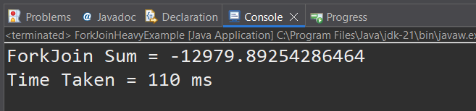
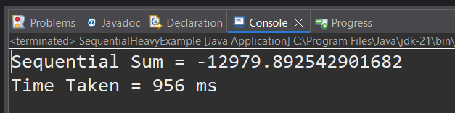
Fork/Join Framework
ForkJoinTask has two main types
RecursiveTask – Return result
RecursiveAction – No result

Slide 170
Different types of Threads
Kernel/OS Thread
This is also known as OS Thread.
Kernel Threads are managed and scheduled by the operating system
Platform Thread
Each Java platform thread is associated 1-to-1 with an OS OR kernel thread

Slide 171
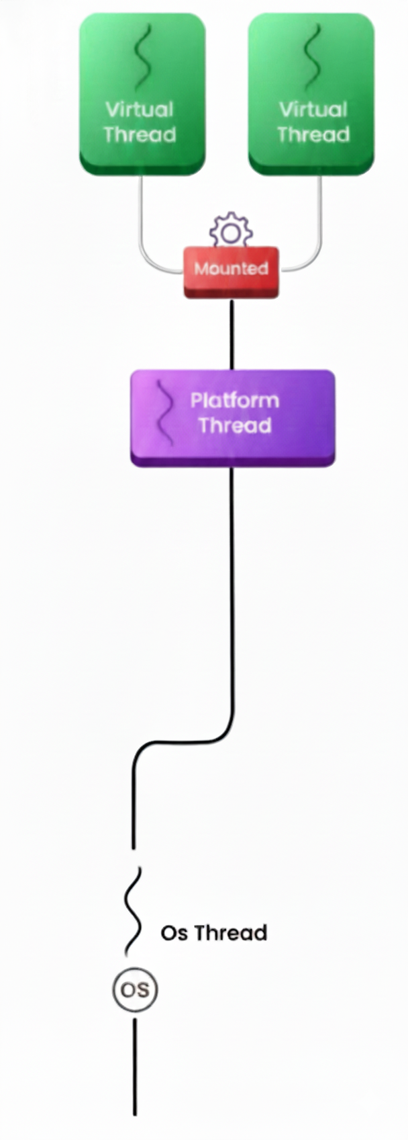
Virtual Threads
A Virtual Thread is a lightweight thread managed by the JVM instead of operating system.
It looks like a normal Java thread but internally
Scheduled by the JVM
Extremely cheap to create
Can block without wasting OS resources

Slide 172
Compare with Platform Thread
Aspect | Platform Thread | Virtual Thread
Backed by | OS thread | JVM scheduler
Creation cost | Expensive | Very cheap
Count | Hundreds / thousands | Millions
Blocking | Wastes OS thread | JVM parks it
Used in | Java since day 1 | Java 19 (Loom)

Slide 173
Why do we need Virtual Threads ?
16 GB RAM
1 Thread = 20 MB
I can create around 800 Threads. (16 *1024 /20)
Single request processing time = 100 ms
Request Preparation 0.1 ms
IO (Database,Disk) Operations
100 ms
Response Preparation 0.1 ms
800 Concurrent Requests
1 Request = 1 Thread
Total CPU time for processing single request =
0.1 ms + 0.1 ms = 0.2 ms
Total Requests are 800 = 800 * 0.2 ms = 160 ms
CPU utilization of 1 second = 160 ms / 1000 ms = 16
CPU utilization = 16%
We are not optimally utilizing the CPU to its capacity

Slide 174
Why do we need Virtual Threads ?
16% = 800 Threads
How many threads do we need to create in order to utilize 90% CPU
Number of threads required = 800 * 90 / 16 = 4500 threads
How much RAM is required for same = 4500 * 20 = 90 GB
Use Case
REST APIs
DB calls
Microservices
Blocking I/O
Not Needed
CPU-heavy tasks
Batch processing

Slide 175
Session 3 : Microservices & JVM Performance
Performance Tuning for Spring Boot/Microservices
Startup optimization (AOT, Native Images)
Memory Footprint reduction
HTTP Connection pool tuning
Using Actuator metrics & Micrometer

Slide 176
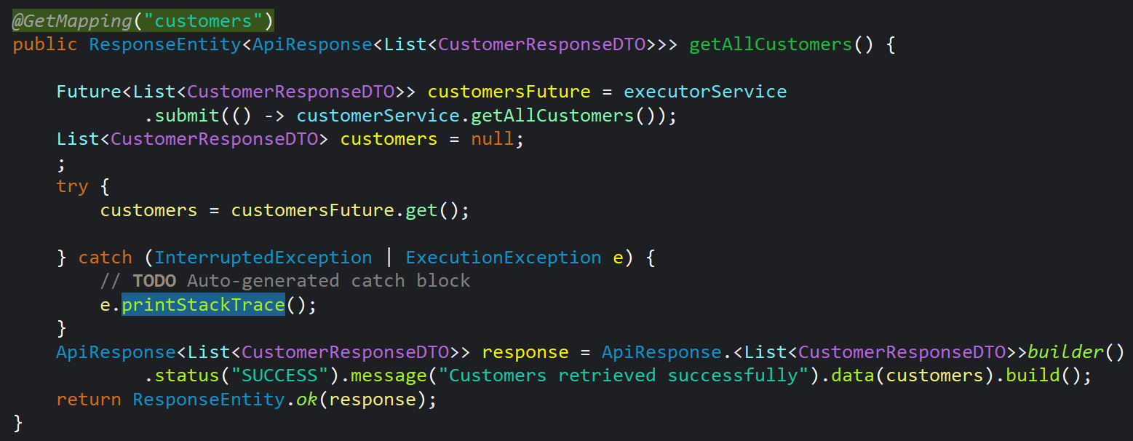
Performance Tuning for Spring Boot / Microservices
Common Bottlenecks
Slow DB calls
Blocking APIs
Thread pool exhaustion

Slide 177
Startup Optimization
Techniques
Lazy Initialization
Spring AOT
CRaC – Coordinated Restored at Checkpoint
GraalVM Native Images

Slide 178
Memory footprint reduction
Techniques
Use Pagination instead of loading full data

Slide 179
GraalVM

Slide 180
Startup Optimization and Memory footprint reduction
GraalVM is a high performance JDK that speeds up the performance of Java and JVM-based applications and simplifies the building and running of Java cloud native services.
The optimized compiler generates faster code and uses fewer compute resources, enabling applications start instantly.

Slide 181
GraalVM : Questions
Why we need to use GraalVM, when I am good with traditional JDKs?
Businesses want to deliver innovative software that scales and automates processes, while also running and consuming fewer resources.
Organizations are moving applications to the cloud and adopting cloud-native architectures like microservices, serverless to reduce costs and improve efficiency.

Slide 182
What happens inside normal JDK?
Java Code
javac Hello.java
.class
java Hello
JVM
Output
Output

Slide 183
What happens inside JVM?
Class Loading
The JVM starts by loading the necessary classes and resources required by the program.
It searches for bytecode files(.class) that correspond to the classes used in the program and loads them into memory.
Bytecode Verification
Once the classes are loaded, the JVM preforms bytecode verification. It checks the bytecode for any violations of the Java language specification.
This step ensures the safety and security of the JVM by preventing the execution of malicious or malformed bytecode.
Just-In-Time(JIT) Compilation
After the bytecode is verified, the JVM employs a Just-In-Time(JIT) compiler to convert the bytecode into machine code. The JIT compiler analyzes the bytecode and identifies portions of the code that are frequently executed, known as hot spots.
It optimizes the hot spots by translating them into highly optimized machine code, specific to the underlying hardware and operating system.
This compilation process is known as dynamic or on-the-fly compilation because it happens during runtime.
Execution
Once JIT compilation is completed, JVM starts executing the optimized machine code.
It interprets the bytecode and executes the corresponding instructions. At this stage, the Java program is running natively on the underlying hardware, similar to programs written in other programming languages.

Slide 184
What happens with GraalVM
JIT mode
Java Code
javac Hello.java
.class
java Hello
GraalVM JIT
Output
Output
AOT mode
Java Code
javac Hello.java
.class
native-image Hello
GraalVM AOT
Native executable code
./hello
Output
GraalVM includes a Native utility to compile applications ahead-of-time(AOT) into native executables. The executables
are smaller, start nearly instantaneously, and consume a fraction of the compute resources needed to run the same java
application on a Java Virtual Machine. It makes GraalVM ideal for cloud deployments and microservices.

Slide 185
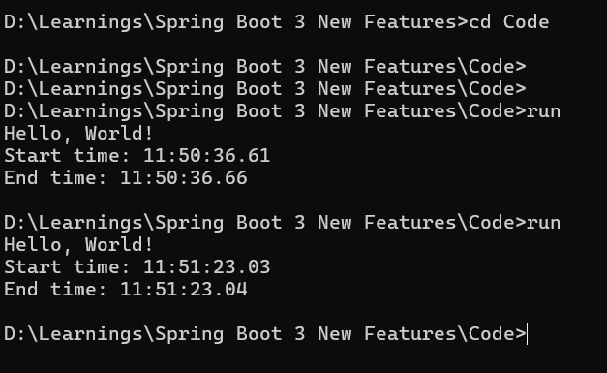
GraalVM : HelloWorld Demo

Slide 186
What happens in GraalVM AOT mode?
Iterative static analysis of the code will be done
by GraalVM until fixed point reached.
GraalVM scans all the reachable classes, method etc. Any unused code will be ignored
Any dynamic code invoked with reflection,JNI, Dynamic proxy etc can’t analysed by GraalVM since it performs static analysis. To overcome this, we need to provide Reachability Metadata to GraalVM
Application classes
Libraries
native-image
Ahead-of-time
compilation
Native executable code
Output
JDK
Substrate VM

Slide 187
Advantages ofGraalVM
Apps start instantly
JIT – Normal Just In Time Compilation
Load JAR files from disk
Extract class files
Verify class definitions
Interpreter logic
Profiling
Compile to machine code
Initiate the start process with full speed
AOT – Ahead Of Time Compilation
Load native executable code from disk
Initiate the start process with full speed
Since the number of steps with GraalVM is less and code is ready for execution in native format, the start time will be less compared to traditional JDK

Slide 188
Advantages ofGraalVM
Low memory consumption
Save Cloud Bill
Compact packaging
Save Cloud Bill
Reduced Attack Surface
Only code reachable by the application are included in the image and no new code can be loaded at runtime.
Reflection, Deserialization etc are disabled and require explicit reachability metadata configuration
Polyglot support

Slide 189
Limitation of GraalVM
GraalVM static analysis may not automatically detected all reflection code, JNI, Dynamic proxy code. Workaround is to provide this information manually to the GraalVM using Reachability metadata.
Maintaining Reachability metadata for our own application code is file, but how about the dynamic code used in libraries and frameworks?
The solution is, all major frameworks like Spring Boot , Quarkus , Micronaut, Helidon are already updated their code to provide this Reachability metadata.
Need lot of computational efforts at build time. Make sure to use a powerful machine with the same platform target and OS. You can’t build on windows and deploy the executables code into Linux server
During local development and unit testing, it will be annoying to use AOT because it takes lots of time to generate native executable code. Instead use JIT and go for AOT only during the final build process.

Slide 190
Actuator metrics
Important Metrics
/actuator/metrics/http.server.requests
/actuator/metrics/jvm.memory.used
/actuator/metrics/system.cpu.usage

Slide 191
Session 4 : Database Optimization
DB latency analysis
JDBC tuning:
Connection pooling
Batch updates
Prepared statements
Hibernate/JPA performance tuning:
N+1 issue elimination
Fetch strategies
Caching (L1/L2)

Slide 192
What is DB Latency ?
Total time taken by DB interaction
Total DB Latency = Network Time + Connection Acquisition Time + Query Execution Time + Result Fetch Time

Slide 193
JDBC Tuning
Connection Pooling
Batch Updates
Prepare Statements

